Slide 1
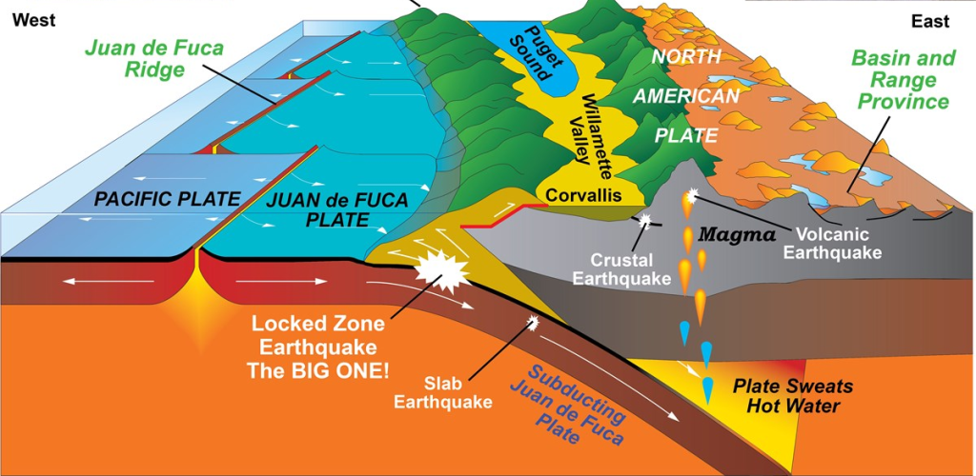
Understanding The Risk
Bridget Good
  503-801-6100
  bridget.shannon.good@gmail.com
  SurvivingCascadia.com
Image Credit: National Park Service
Notes:
Hi, my name is Bridget Good. I support the Mitigation and Recovery division here at OEM. First, a bit about who I am as a presenter, and who I’m not.
The science discussed today, first and foremost, isn’t mine! It comes from field experts, whose findings stands on top of decades and even centuries of prior scientific discoveries. These findings were made possible by teams of global collaborators from a variety of fields. So who I’m not— I’m not an expert in this field.
The information I’m sharing today originates from questions that I started asking those field experts 5 years ago when I worked as an Operations and Policy Analyst for the state.

Slide 2
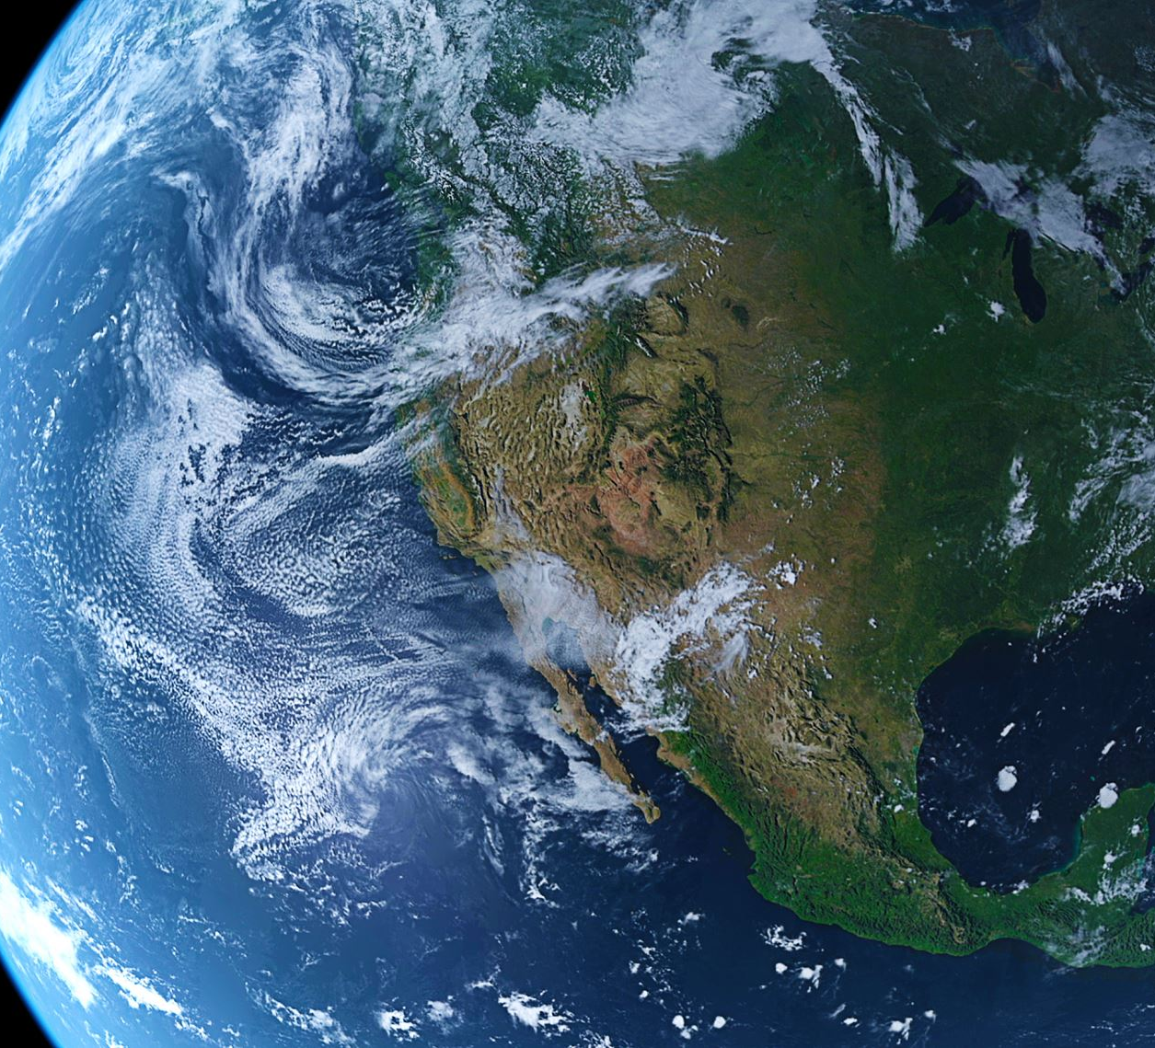
Agenda
What is the probability that a Cascadia megathrust earthquake will occur in the Pacific Northwest?
Probability
Failure Analysis
Average Recurrence Intervals
Notes:
Today is about answering two basic questions:
What is the likelihood that a Cascadia Subduction Zone earthquake will happen in the next 50 years?
How frequently have these earthquakes occurred in the past?
Hint: The answers may not be what you expect.

Slide 3

Notes:
For those asking, “what are the chances that this earthquakes happens?” they are likely to find this answer…

Slide 4
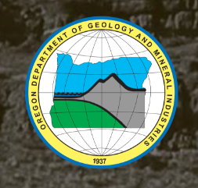


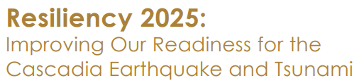

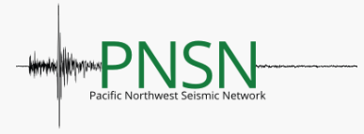





37% chance in the next 50 years
(sometimes discussed as a ≈ 1 in 3 chance)
DOGAMI Link
OEM Link
USGS Link
Resiliency 2025 Link
Community Planning Events
OSU Link
PNSN Link
PBS Link
Oregonian Link
New Yorker Link
AP Link
LA Times Link
Notes:
In some cases, the 37% chance is described as a roughly 1 in 3 chance, but in both variations this answer is fairly pervasive. It can be found in publications from various universities and state agencies like those shown here.
[Slide-In]
And from those sources, the probability is further circulated to the public through news organizations, including the infamous New Yorker article that made headlines of its own.
[Slide-In]
From there, it moves at the community level.
[Slide-in]…
37% percent in 50 years. Many read this, flip it and say, well that’s like saying there is a 63% chance it won’t happen… and they’re really not all that vested in jumping into preparedness action.

Slide 5
Risk perception
Refers to people’s subjective judgments about the likelihood of an event, situation or outcome.
Notes:
It comes down to Risk Perception: someone’s subjective judgement of the likelihood of an event, situation or outcome. That underlying “63% chance it won’t happen in 50 years” sends a pretty loud perception message.
And this matters because I believe we choose to prepare – or not – based on our perceived risk. So I started wondering where the quote comes from.

Slide 6
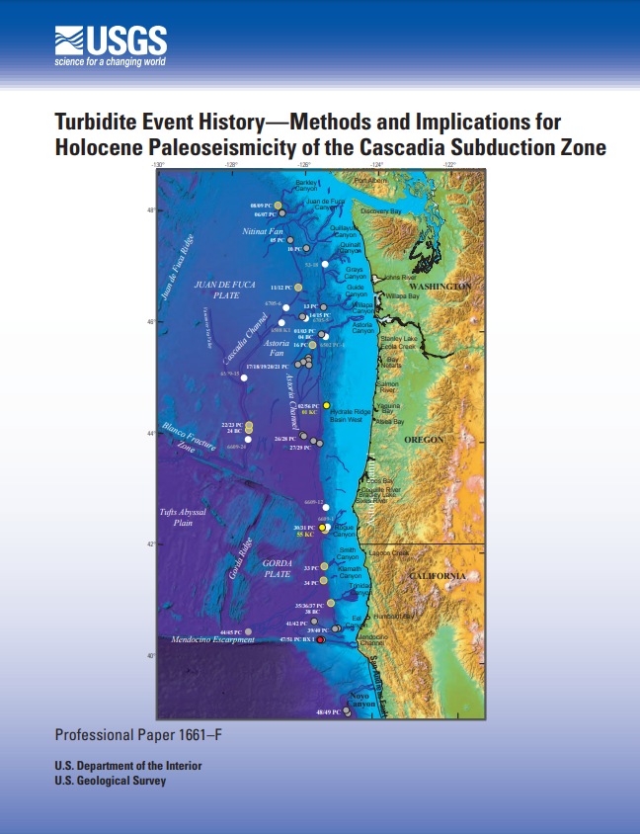

Goldfinger, C., Nelson, C.H., Morey, A.E., Johnson, J.R., Patton, J., Karabanov, E., Gutierrez-Pastor, J., Eriksson, A.T., Gracia, E., Dunhill, G., Enkin, R.J., Dallimore, A., and Vallier, T., 2012, Turbidite event history—Methods and implications for Holocene paleoseismicity of the Cascadia subduction zone: U.S. Geological Survey Professional Paper 1661–F, 170 p, 64 figures, available at http://pubs.usgs.gov/pp/pp1661/f
Notes:
Some digging and we find that the percentage originates from this USGS paper. It’s 184 pages long. Within it, data is provided on the process of obtaining soil samples offshore of the Pacific Northwest, identifying past earthquakes up and down our coast range, and dating the samples for estimated ages of the earthquakes. From all of that, probabilities are provided.

Slide 7

2012
According to the National Science Board (NSB), 18,686 articles in geosciences, atmospheric, and ocean sciences were published in the United States that year.
Notes:
Now just real quick, it’s worth mentioning that this paper was just one of over 18 thousand publications in geo, atmospheric and ocean sciences in the US in 2012. When we think of all the papers published from other countries around the world that year and all the years before and since, finding a single probability in a 184-page publication that is just 1 of thousands of publications every year is a bit like finding that needle in a haystack. Yet, we put a lot of stock into this risk probability, so it’s good to know where the data comes from.

Slide 8

Center stage
“Time-dependent probabilities are similar for Northern margin events at ~7–12 percent and 37–42 percent in 50 years for the southern margin.” – pg. 2
Notes:
Now let’s, just for a second, think about this paper like a play occurring at a nice theatre. Each fact, like a prop, setting or performer.
A Theatre Lighting Technician has focused the brightest light on this single statistic from page 2, shown here in purple.

Slide 9

We do have to help [citizens] understand that facts are not very useful unless we know how to ask the right questions about them.
-Jim Grossman, historian and executive director of the American Historical Association
Notes:
But single facts don’t always tell the whole story and they’re usually not meant to. That bright light, after all, is just one spot for our eyes to focus. The story is so much bigger.
During a PBS interview in July of this year, Historian and executive director of the American Historical Association, referring to a different topic entirely, said the following:
[read quote]
When it comes to Cascadia timing, this quote rings pretty true for me, because when I started researching this topic 5 years ago, I didn’t expect to find what I found
And I didn’t expect what I found to so completely alter my risk perception of the Cascadia Subduction Zone timing.

Slide 10

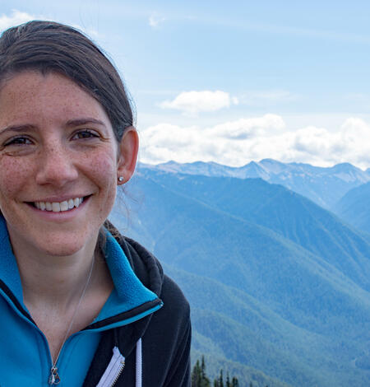

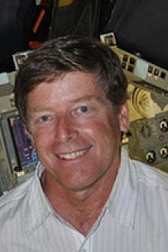
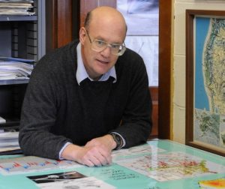
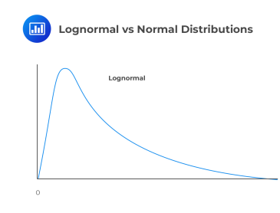
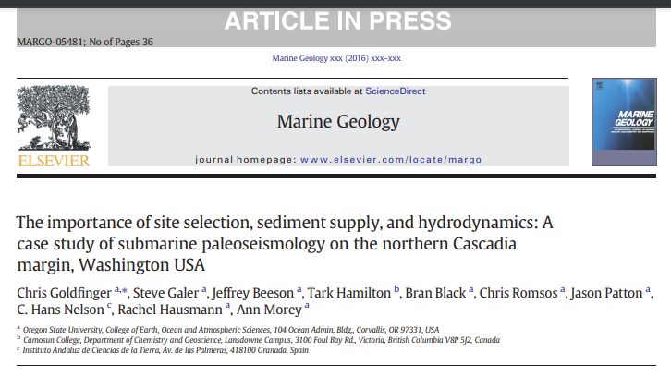
Shine the light on the 1st sentence:
37% chance
in 50 Years
Notes:
It started with understanding the number better. These researchers, Professor John Vidale, Dr. Erin Wirth Moriarty, the late Professor Bob Yeats, and Professor Emeritus Chris Goldfinger helped me learn that the 37% comes from a Lognormal equation like the one shown here.
[Slide-in]
The original lognormal equation for this was created in an Excel worksheet by Professor Seth Stein at Northwestern University. He was using it for risk relating to the New Madrid Zone.
[Slide-in]
The worksheet was shared and adapted to the CSZ data by Professor Goldfinger and his team.
So now I started wondering, well, the risk was 37% in 2012 when the paper was published. What is it now? I really wanted to be able to play with the numbers.

Slide 11
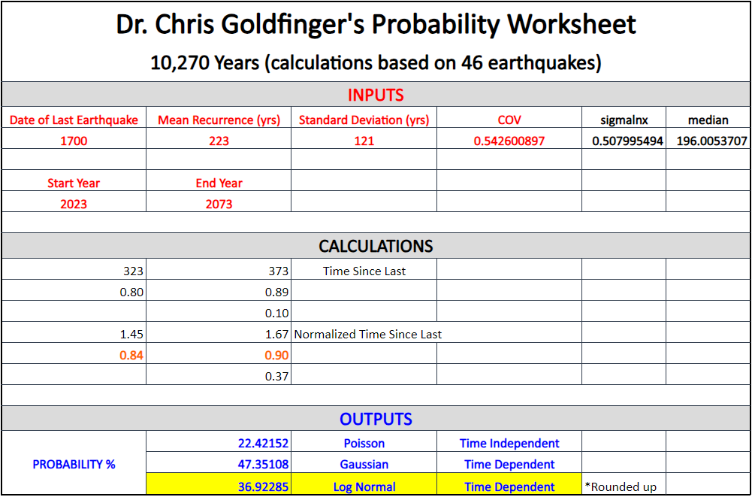
50-Year Outlooks
Lognormal =
2023-2073 36.92 ≈ 37%
1973-2023 36.71 ≈ 37%
2073-2123 36.69 ≈ 37%
Notes:
Thankfully, Professor Goldfinger was willing to send me his spreadsheet, answer my numerous questions and help me to better understand the data.
The Excel sheet is simple to use. You input the red fields. The middle section does it’s magic & it spits out the blues. For the red inputs, we know the last earthquake was in 1700. Professor Goldfinger provided the mean and SD, so to play with the numbers, we just change the start and end years to see how the probability changes over time. With a start year of 2023, end year 2073 for a 50-year outlook, the lognormal equation at the bottom, highlighted in yellow, is 36.92 rounding up to 37%... Meaning the probability is the same 11 years after the paper was published.
So more questions came. I started wondering what the risk would have been 50 years ago. My assumption was that it would have been quite a bit lower since the pressure on the fault had had less time to accumulate. I was half right.
[fade in]
It was lower… but not quite a bit. It was barely, still rounding up to 37%, which made me wonder what the risk would look like 50 years out from now. I assumed it would be slightly higher than it is now. This time…
[fade in]
I WAS WRONG! Like all the way wrong. Start and end years 2073 to 2123 has a probability that is not only lower than the current risk, it’s lower than the risk would have been 50 years ago... What!!

Slide 12
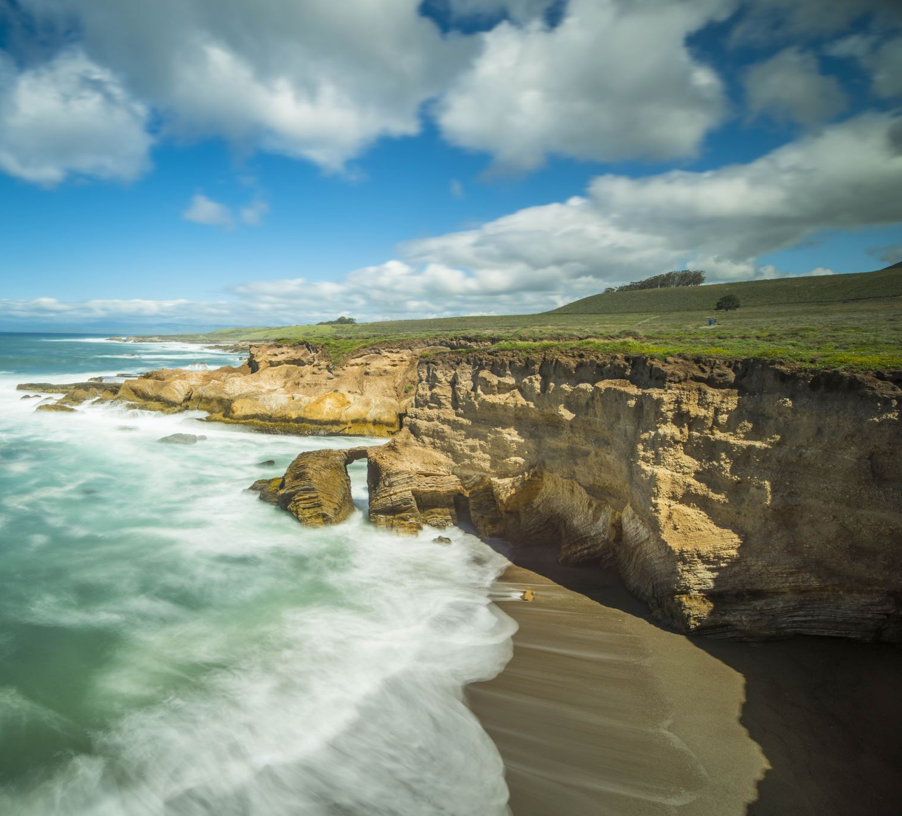
Shape
Notes:
It comes down to the shape of that curve. At some point, the risk peaks like the edge of this cliff here. And then it starts to come back down. Next question to ask… when?

Slide 13
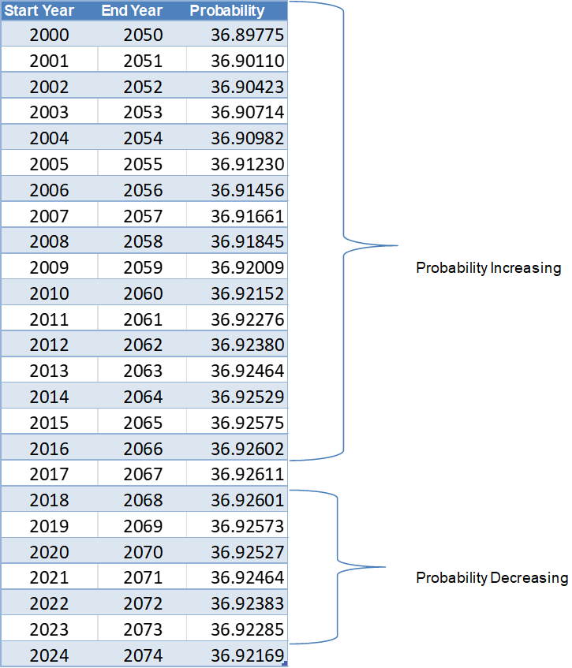
So now what???
Notes:
It turns out, if we enter 50-year timeframes, and evaluate at the probability at 5 decimal points, the probability model used in that 2012 USGS paper shows that our risk of a Cascadia Subduction Zone earthquake was highest in 2017 and has been going down ever since.
Of course, that’s not the case. Pressure on the fault continues to build.

Slide 14
Shrug
Can’t account for continual building of stress
Can’t account for possible earthquake clustering
Includes 46 earthquakes.
10,272 Years (date of earthquake T19, the last in the 10,000-year series) / 46 earthquakes = 223
Notes:
The shape of the curve is only 1 of 3 issues with this model.
It can’t account for possible earthquake clustering, which is a topic for another day… provided by someone other than me!
And it is based on data for 46 earthquakes.
[Slide-in]
Again, here are the mean and SD provided by the OSU team, and to the right, the math showing that 46 earthquakes are used to obtain the mean of 1 earthquake every 223 years. Just a reminder that the Pacific Northwest has gone 323 years…

Slide 15

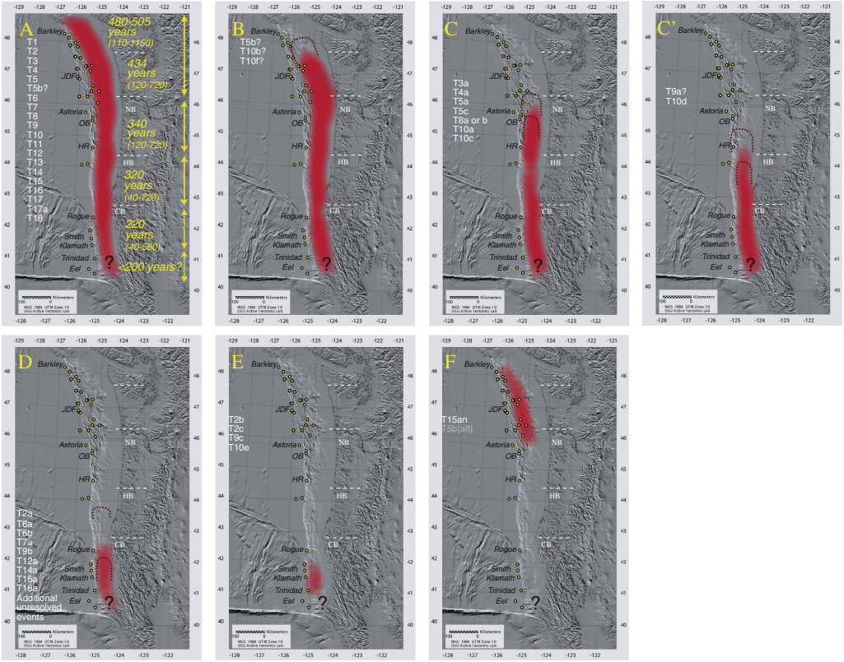
Fig. 18. Goldfinger, C., et al., The importance of site selection, sediment supply, and hydrodynamics: A case study of submarine paleoseismology on the northern Ca..., Marine Geology (2016), http://dx.doi.org/10.1016/j.margeo.2016.06.008
Notes:
4 of those 46 earthquakes are assigned to what’s known as Segment E, shown here with the boarder. This image was presented in a 2016 follow-up paper to the USGS publication. Those 4 earthquakes are the smallest and their status as being considered part of the Cascadia record is currently being reconsidered. Professor Goldfinger explains that they are small enough that it is hard to tell if they in fact the result of a CSZ rupture. They could be NSAF, Perolia, Gorda plate or other. Changing the 46 to 42 would alter the mean and SD of that lognormal formula that gave us the 37%.

Slide 16
37% chance in the next 50 years
Notes:
Despite the drawbacks to this statistic, it remains the top quoted risk out there.
[Slide in]
But ultimately, I no longer use this probability when talking about the likelihood of an event…

Slide 17
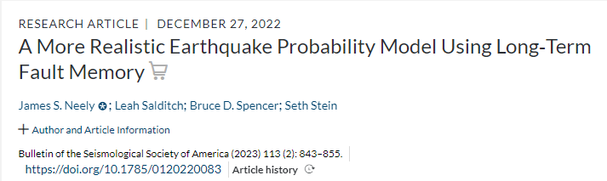
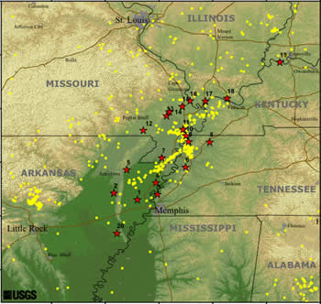
Other Options?
Log-Normal vs…
Long-term Fault Memory Model
Link to the article
https://www.usgs.gov/media/images/new-madrid-seismic-zone
Notes:
And I’m not alone. Researchers are, of course, aware of the drawbacks and have been working toward a model that can better represent the behavior of faults over time. A team of researchers at Northwestern University has developed the long-term fault memory model. They applied the model to data from the New Madrid fault.
[Slide in]
Work is underway to apply the model to Cascadia data, so for now, we wait…

Slide 18
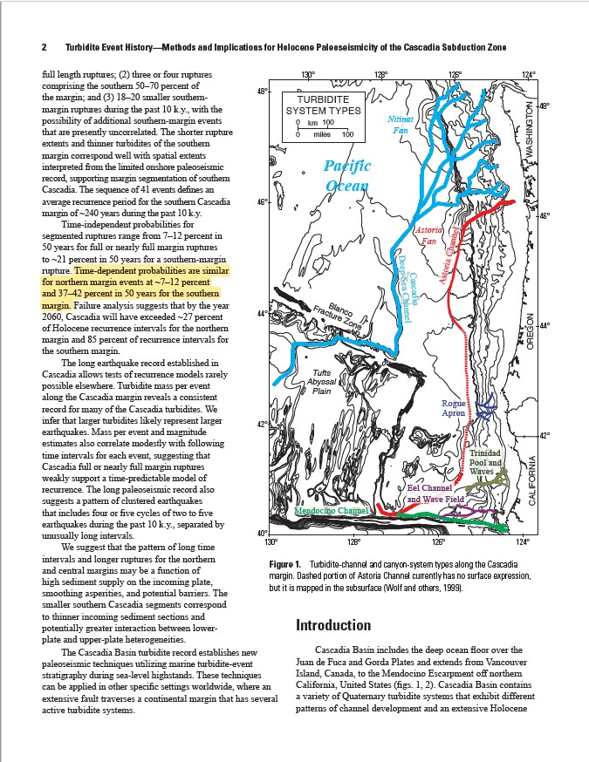

Center stage
Notes:
Back to our analogy of a play. Let’s say we want to keep the same performance, actors, lines, and setting, in other words, we are going to look at this same research publication, same data and even the same page, but we’re going to ask the lighting technician to move his spotlight just 1 sentence down..

Slide 19
Center stage
Failure analysis suggests that by the year 2060, Cascadia will have exceeded
~27 percent of Holocene recurrence intervals for the northern margin [full-margin rupture] and
85 percent of recurrence intervals for the southern margin [any megathrust rupture on the fault, partial or full-margin].
Notes:
Here’s that new sentence that we’ve moved to center stage… By 2060 we will have surpassed 85% of all recurrence intervals?? Huh? That seems like a pretty high percentage. How many had we already passed? I wanted to see those intervals.

Slide 20
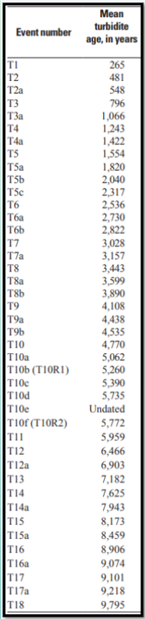
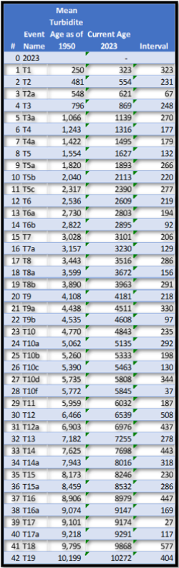
Table 10, page 97
“Dates are reported as calendar years before 1950, unless otherwise noted, and appear in the text as “cal yr B.P.”
–page 16
Event T10e (undated)
Event T19 from page 32
“We use turbidite-event numbering T1–T19 to designate these full-margin events”
–page 110
Notes:
And for that, I needed the estimated ages of the past Cascadia Megathrust earthquakes. They are listed on page 97 of the paper.
From this list which is just a screen snip of Table 10, we take away event T10e which is one of the “smaller” earthquakes from segment E that I talked about earlier. It remains undated and its status as part of Cascadia’s record is in question.
[Fade-in]
This leaves us with 41 major earthquakes in the most-recent 10,000-year history. However, we need to add one more.
[Fade-in]
The publication adds event T-19 to the data used in probability modeling. Despite its age, estimated at roughly 10,200 years ago—just over the 10,000-year threshold—T19 was included because it also occurred prior to the Pleistocene-Holocene transition, and the data is basically trying to capture the history during the Holocene. This takes us to 42 events.
If we plug these dates into Excel, we can calculate out how many years there were between earthquakes, also known as the intervals.

Slide 21
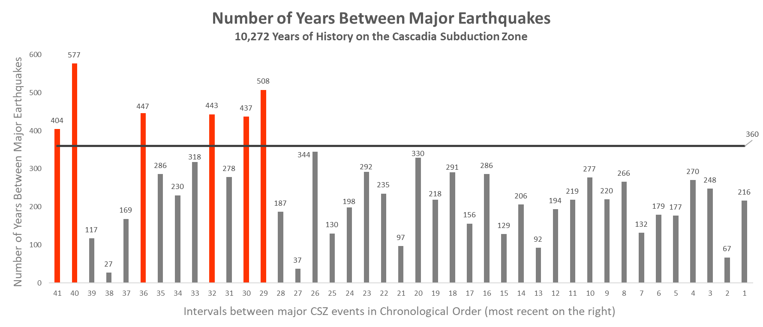
Year 2060
Notes:
The we have Excel display those intervals in a bar graph. Each bar represents the number of years in a single interval and the intervals are listed in chronological order with the oldest—the interval between T18 & T19 on the left and the newest on the right.
The horizontal black line in the graph runs at 360 years — the time that will have passed between the last major CSZ quake in 1700 and 2060 (the year mentioned in the USGS paper) if an earthquake doesn’t occur by then. Intervals over 360 years are shown in red, while shorter ones are in grey.
Only 6 intervals stretch above the black line… and they’re clumped together. More on that in a minute.

Slide 22
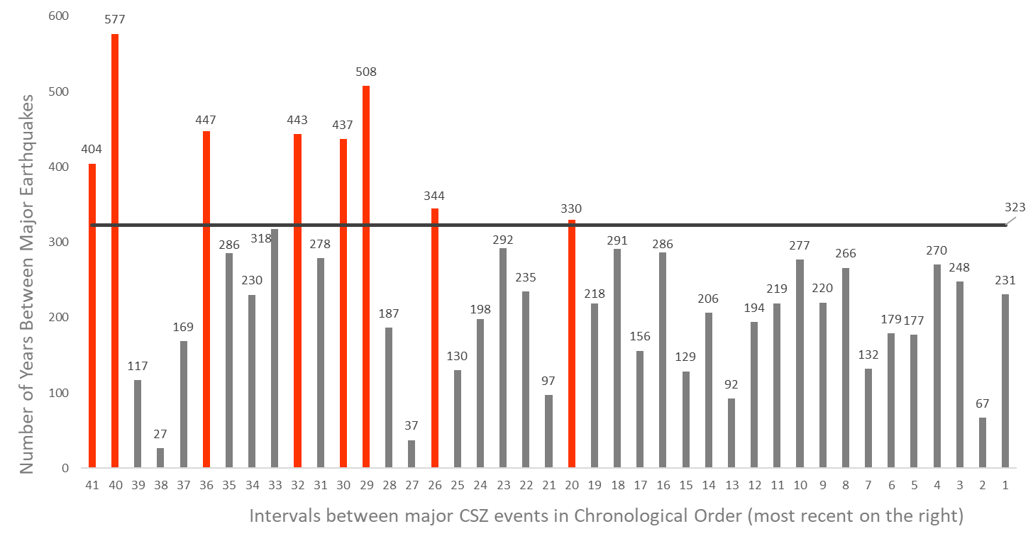
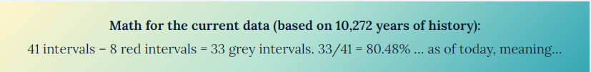
Year 2023
Notes:
Okay, but that’s in 2060, which is still 37 years away. What does the current data look like?
The Pacific Northwest has currently gone 323 years without a megathrust earthquake.
This bar graph drops the horizontal black line to 323 years, helping to easily identify past intervals that lasted longer than our current quiescence.
As before, intervals longer than 323 years are shown in red. There still aren’t many. If we look at the math,
[Fade-in]
80% of the time, the fault has not had to wait 323 years for the strain to break it. And notice
[Fade-in]
when the longest intervals occurred.

Slide 23
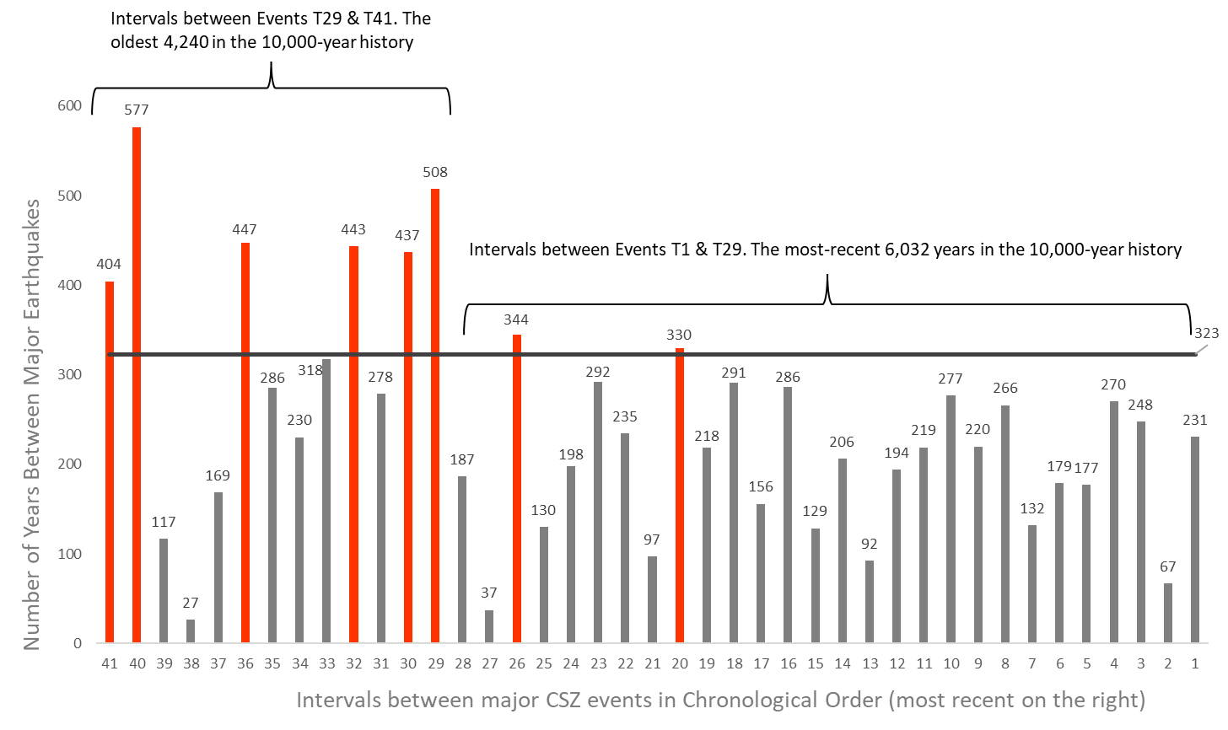
Notes:
They are grouped in the oldest 4,000 years of history. Intervals 1 – 28 include the most-recent 6,000 years.

Slide 24
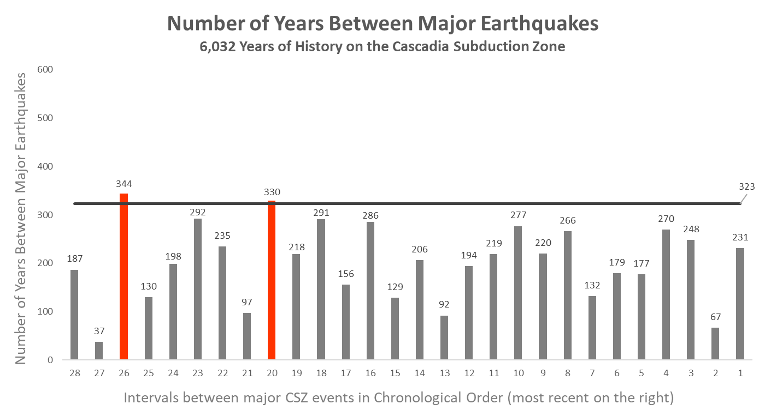
Most-Recent 6,030 Years
Notes:
Let’s zoom in on the most recent 6,032 years of CSZ history. Only 2 intervals (shown in red) have been longer than the black line. The two red lines don’t stretch far above! One is 7 years out; the other is only 21.

Slide 25
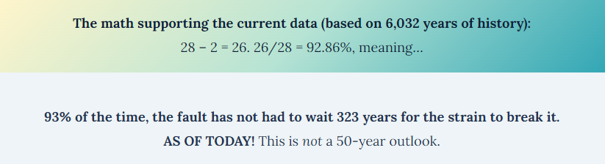
Most-Recent 6,030 Years
Notes:
[Read slide]
The Pacific Northwest hasn’t had an interval over 350 years in over 6 millenia… and we’ve already gone 323 years.

Slide 26
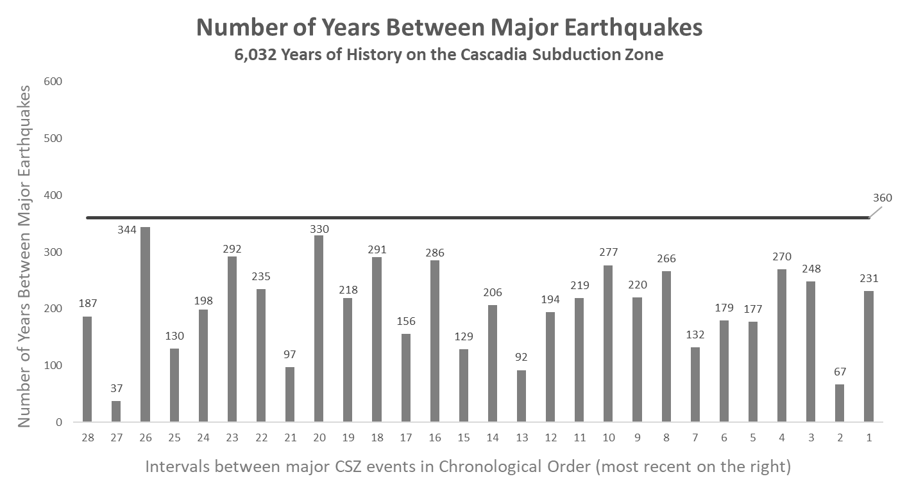
Going Full Circle
37-Year Outlook…?
Nope!
Only a 22-Year Outlook
Notes:
Looking at this 6,032 years of data and projecting out 37 years to 2060, the year discussed in the USGS paper… not a single interval would reach that high. In fact, the Pacific Northwest only has 22 years until it passes the longest interval in the most recent 6,000 years. 22…
[Fade-in]
[Fade-in]
[Fade-in]
If only the most recent 6 millennia are considered, we only have 22 years until we pass the longest interval in the record.

Slide 27

How do we currently discuss timing?
These earthquakes happen every ____ to ____ hundred years…
Notes:
When I leaned about those interval lengths, my mind was blown. My risk perception had changed.
But not everyone loves hearing about probability numbers. Let’s say rather than wondering about probability, you are a community member who just wants to know, how often do these earthquakes happen.
So you decide to go in search of the answer through reputable resources…

Slide 28
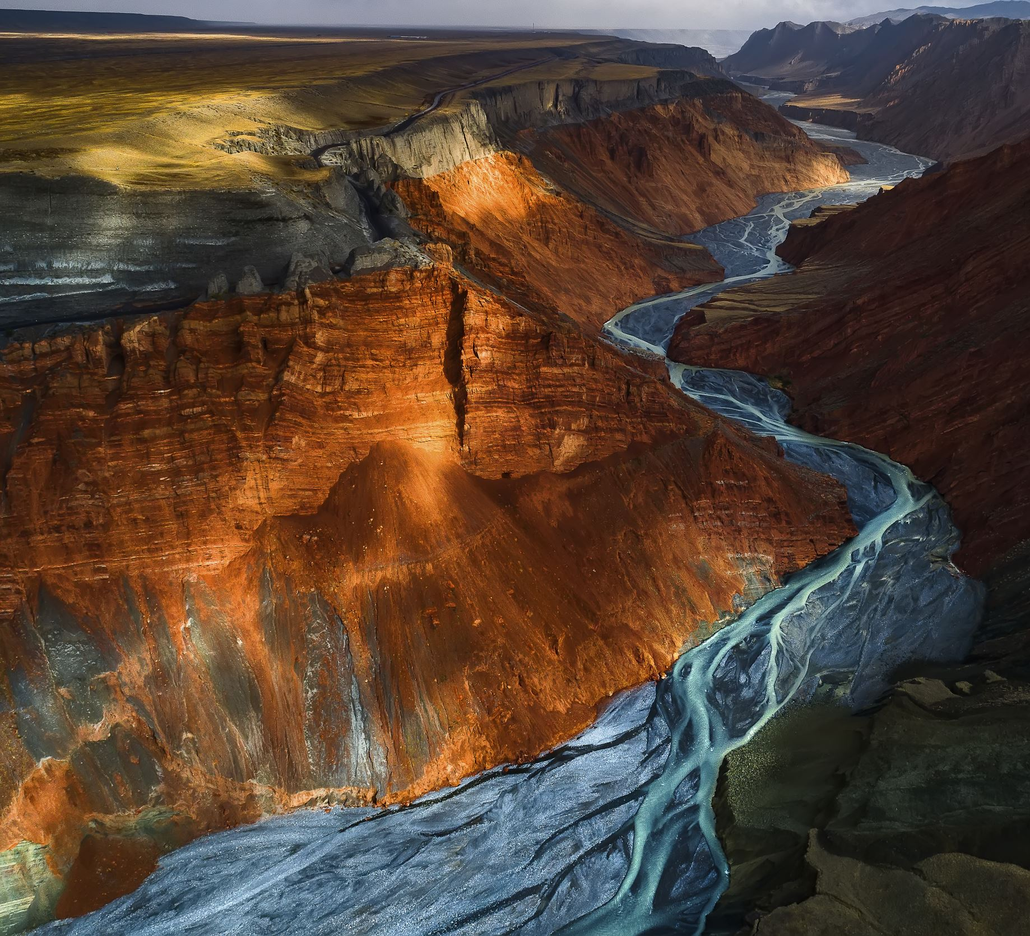
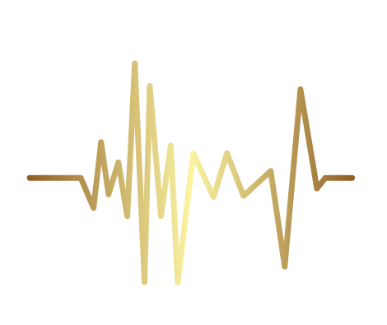
Every 500 – 600 Years
-Government of Canada
-Cascadia Region Earthquake Workgroup (CREW)
Every 300 – 600 Years
-State of Oregon Emergency Operations Plan (Oregon EOP)
Every 400 – 600 Years
-Pacific Northwest Seismic Network (PNSN)
Every 300 – 500 Years
-USGS
-City of Seattle
-Berkeley Seismology Lab
You are here
300 Years
400 Years
500 Years
600 Years
January 26, 1700
323 Years
Notes:
If we think about two earthquakes being the sides of this canyon and the space between as the interval, what we are essentially asking is, “how wide is the canyon, on average?”.
Regarding the CSZ megathrust earthquakes, that community member would find answers like these.
[Slide-in & Read]
[Slide-in & Read]
[Slide-in & Read]
[Slide-in & Read]
You can see how it would be confusing. Who has the right answer and why do the answers differ? But more importantly for today’s conversation, what risk perception do these provide? We know when the last earthquake happened.
[Slide-in & Read]
And so we know how long we have gone without an event
[Slide-in & Read]
So the interval spans on this page give a perception sort of like this time map.
[Slide-in & Read] And the risk doesn’t feel so very urgent…

Slide 29
Year 2023
Notes:
But if we look here again, does saying the intervals happen every 300 – 600 years feel like the best representation?
Rather than looking at the intervals chronologically, as they are laid out here, let’s see how they look when they are listed from smallest to biggest…

Slide 30
292
291
286
286
198
278
You are here
194
277
Start
100 Years
200 Years
300 Years
400 Years
500 Years
600 Years
187
270
179
266
177
248
169
235
230
97
156
220
92
132
344
447
219
67
130
218
330
443
37
129
216
323
437
577
27
117
206
318
404
508
Start
100 Years
200 Years
300 Years
400 Years
500 Years
600 Years
700 Years
800 Years
900 Years
1,000 Years
1,100 Years
1,200 Years
Notes:
Here we have 41 boxes, each representing 1 interval. The number inside each box is the number of years that passed between two adjacent megathrust earthquakes. The numbers are the same as in the previous bar chart, coming from the years provided in the 2012 USGS paper.
If you were to look at this and tell someone how often these earthquakes occur, on average, Would you pick the 300 – 600-year timeframe?
[Slide-in]
OR how about this range?
[Slide-in]
It bears repeating, if the scientists are correct on the timing of these past earthquakes, the PNW hasn’t gone longer than 350, well technically 344 years, without an event
[Slide-in]
In over 6 millennia. And even if we look at this full 10,000-year history, I believe it is more accurate to say,
[Slide-in]
We are here. How we talk about this risk matters. It impacts our risk perception, which ultimately guides our motivation….

Slide 31
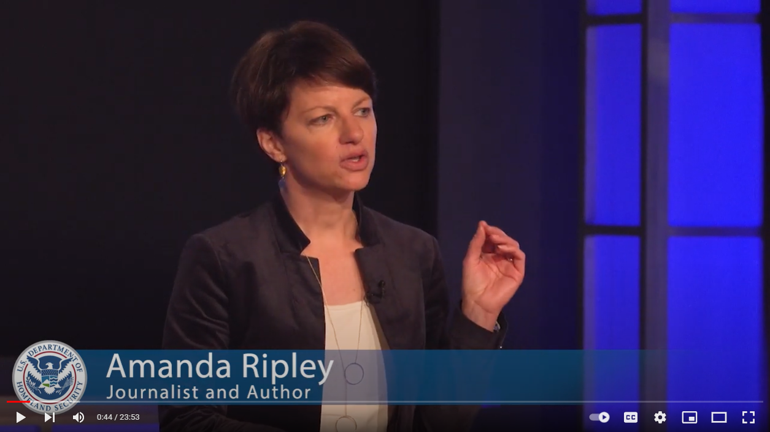
Notes:
So we’re down to our last two slides and a couple of final thoughts to leave you with. This is a screen snip from a 2018 FEMA PrepTalk by Amanda Ripley titled "The Unthinkable: Lessons from Survivors“
“It is the regular people, your friends and family, and coworkers and hotel workers who will be there for you in a disaster, so our best chance is to trust them more with more information sooner. More transparency than we’re comfortable with. Then we know we are doing it right.”

Slide 32
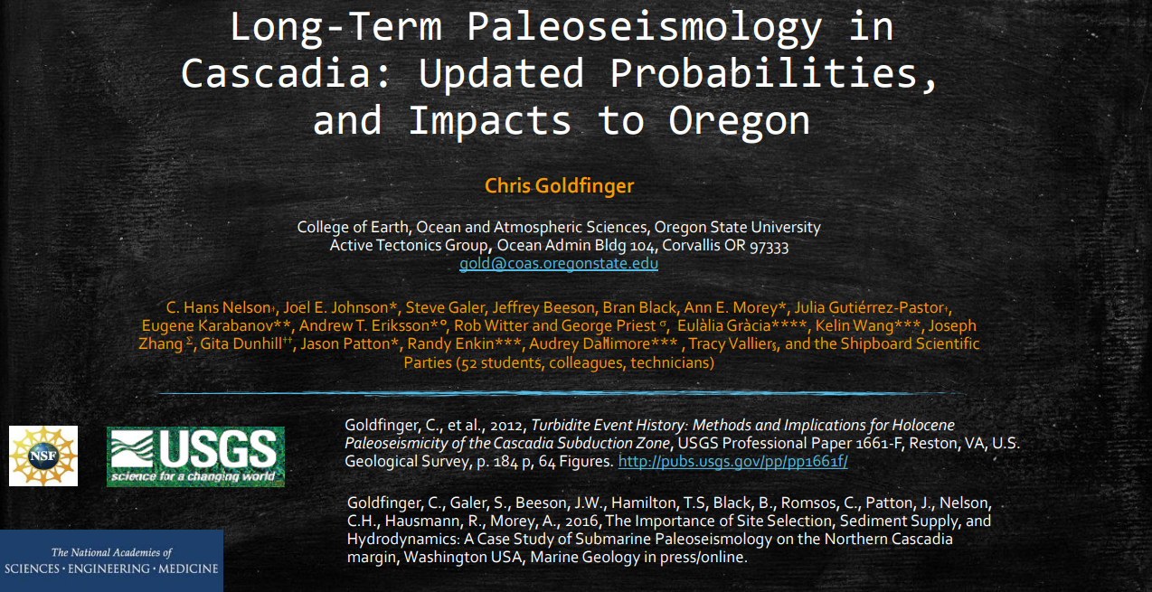
Notes:
So here, written in orange, are the scientists involved in gathering the earth cores, analyzing the data and publishing the 2012 and follow up 2016 papers cited at the bottom. They have worked to provide this information to us so—information that goes beyond a simple fact, that provides a backstory worth knowing.
Again, my name’s not on this list. I’m not on stage for the play, but what I hope to have done well today is serve as that lighting technician, adjusting the spotlight in a slightly different direction than where we normally focus.

Slide 33

Questions?
Notes:
Thank you very much for being here and listening today. I’m very grateful to have had the opportunity to present. If there’s time, I’m happy to take questions, or you can drop them in the chat, along with your email address and I’ll get back to you with an answer soon.

Slide 34
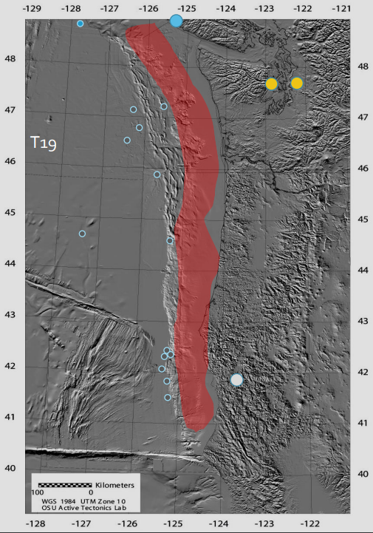
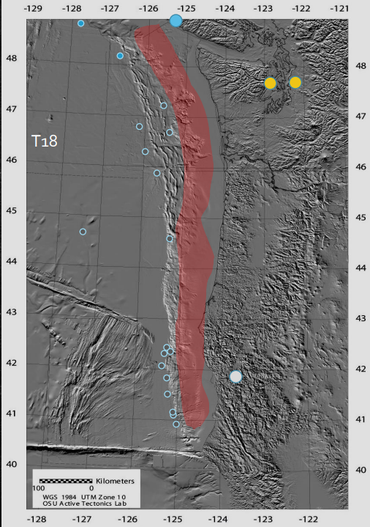
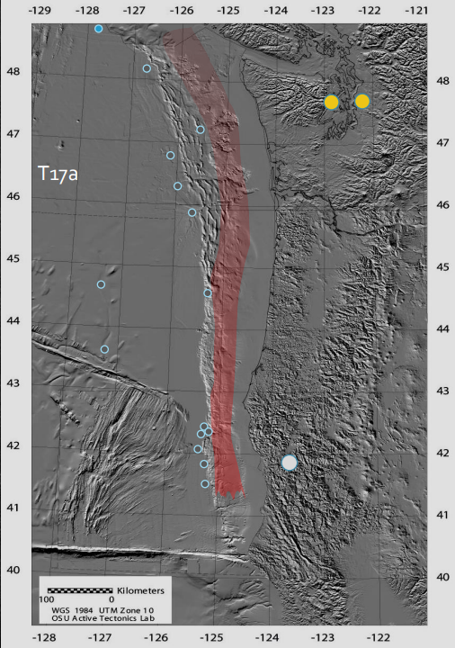
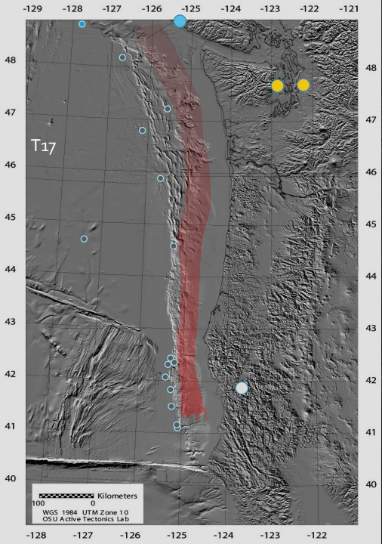
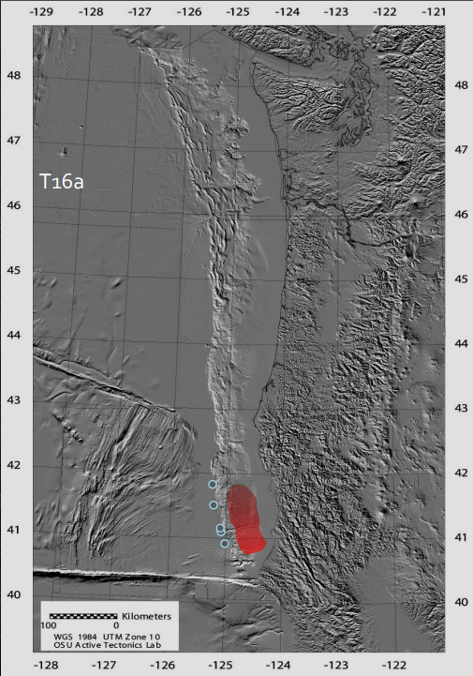
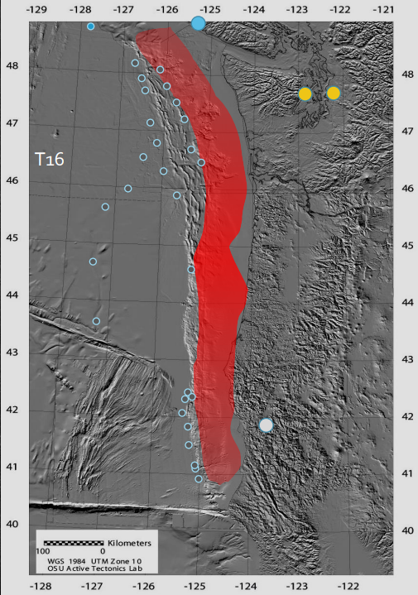
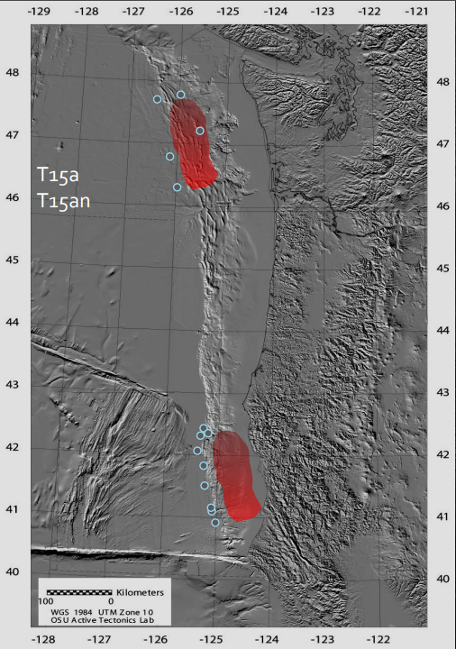
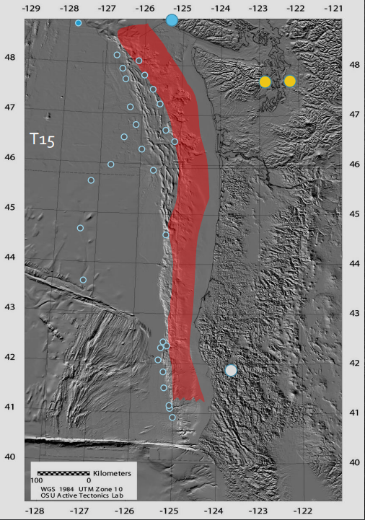
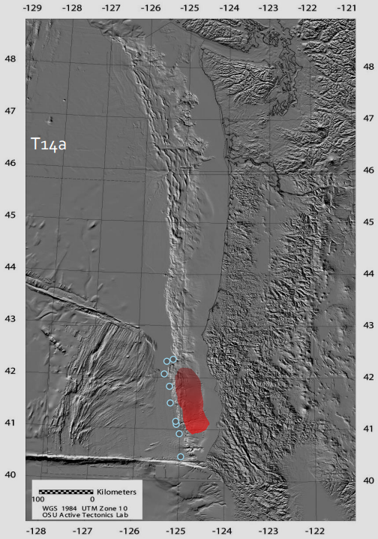
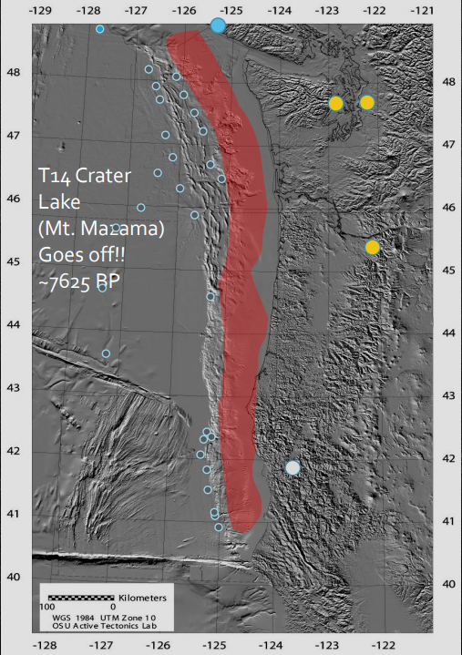
Mw 9.08
Mw 8.50
Mw 8.49
Mw 7.54
Mw 9.09
Mw 8.36
Mw 8.97
Mw 8.17

Slide 35
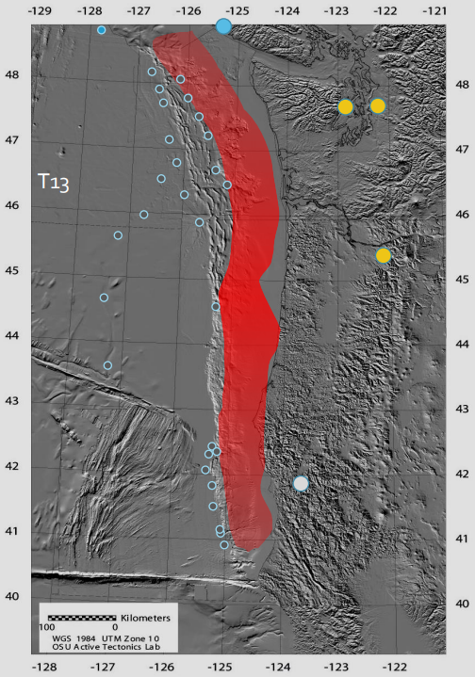
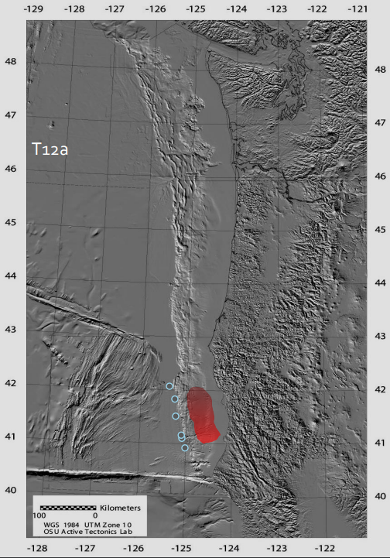
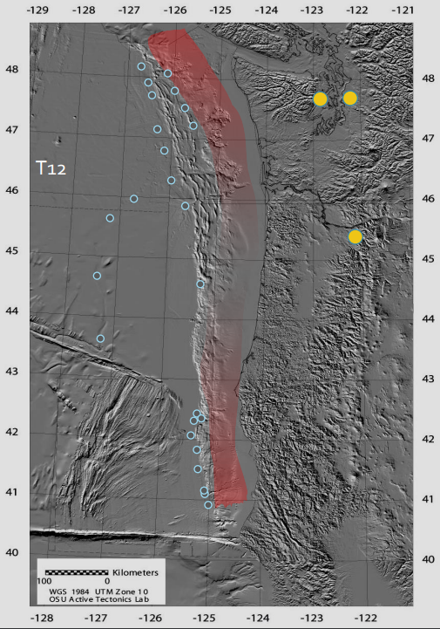
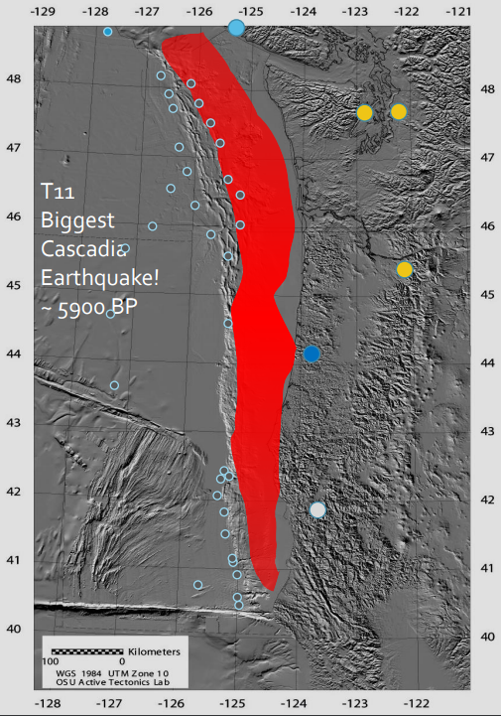
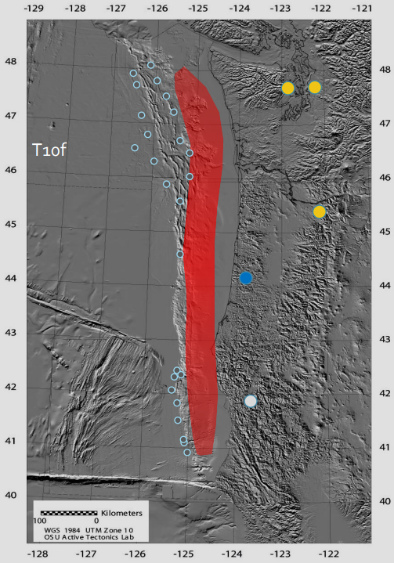
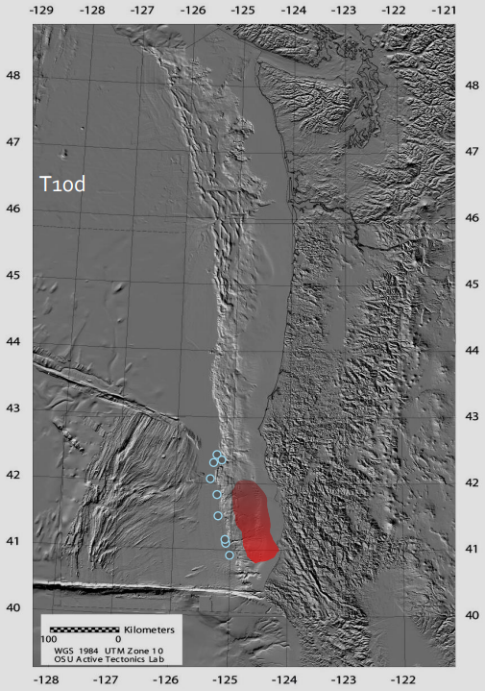
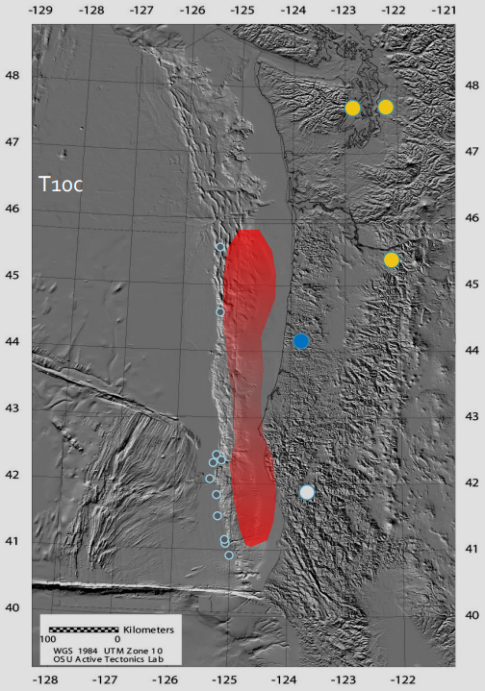
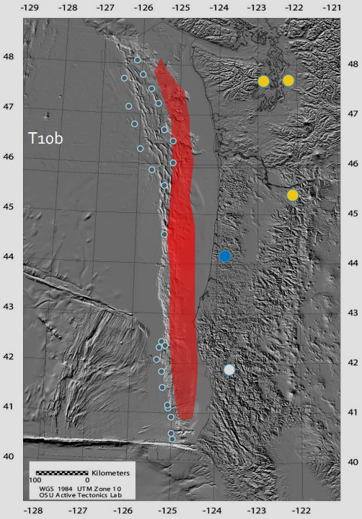

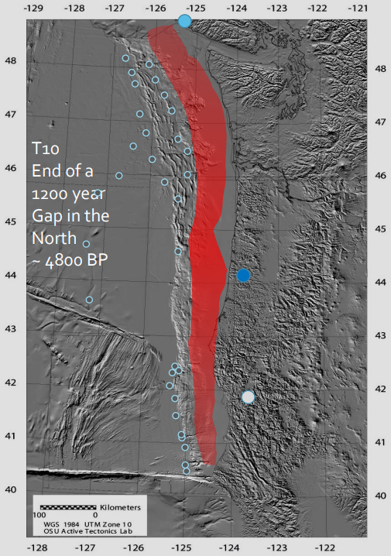

Slide 36











Slide 37











Slide 38






Long-Term Paleoseismology in Cascadia: Updated Probabilities, and Impacts to Oregon
These are the final 4 in the record that led to 46 being used for the 37%

