Slide 1

Creekside Neighborhood Preparedness Get-Togethers

Slide 2
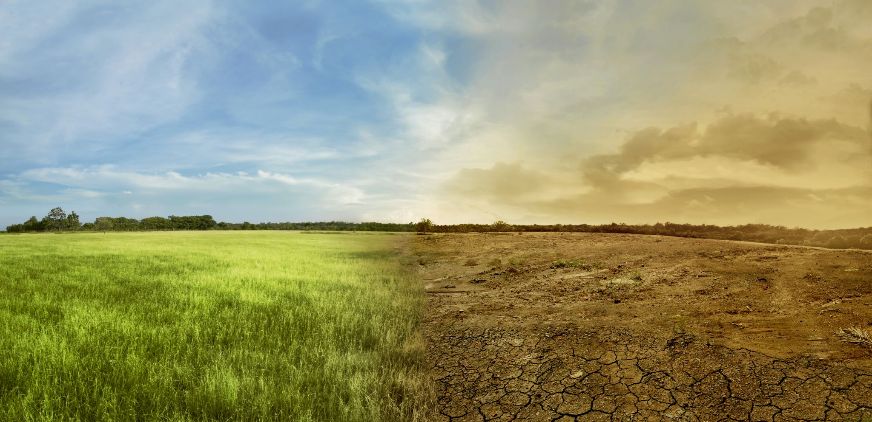
Thought for the day
There have been 42 Cascadia megathrust earthquakes larger than Magnitude 7.5 in the last ≈10,200 years
If the scientific age estimates of those earthquakes are correct…
The Pacific Northwest HAS NOT had an interval longer than 344 years in over 6 millennia.
And the region has already gone 323 years since the last event.
The next megathrust earthquake could be minutes from now or way down the road. It can’t be predicted, so the time to get ready… is now!
Be the hero of your story. Take the time to get 2-Weeks-Ready.

Slide 3

Evacuating vs. sheltering in place
Quick 3-slide reminder about the expected impacts for the region…

Slide 4
Expected Impacts
Area of land impacted by a magnitude 9.0
140,000 square miles—an area slightly larger than all of Germany
FEMA Region 10 Cascadia Subduction Zone (CSZ) Earthquake and Tsunami Damage Impacts Overview
Population at risk (based on 2014 data)
15 million (2021 saw 20,887,470 tourists in Oregon throughout the year)
OEM: The Impacts of the Cascadia Subduction Zone Earthquake on Oregon
Possible shaking duration
6.68 minutes across a fault that runs 621 miles long and roughly 60 miles wide
State of Oregon Cascadia Subduction Zone Catastrophic Earthquake and Tsunami Operations Plan

Slide 5

Oregon Resilience Plan
24,000 buildings completely destroyed
85,000 buildings with extensive damage
$32 billion in economic losses
27,600 displaced households… on top of our current housing shortage
10 million tons of debris (1 million dump truck loads)
1,000 tons of feces produced daily… with no running toilets

Slide 6
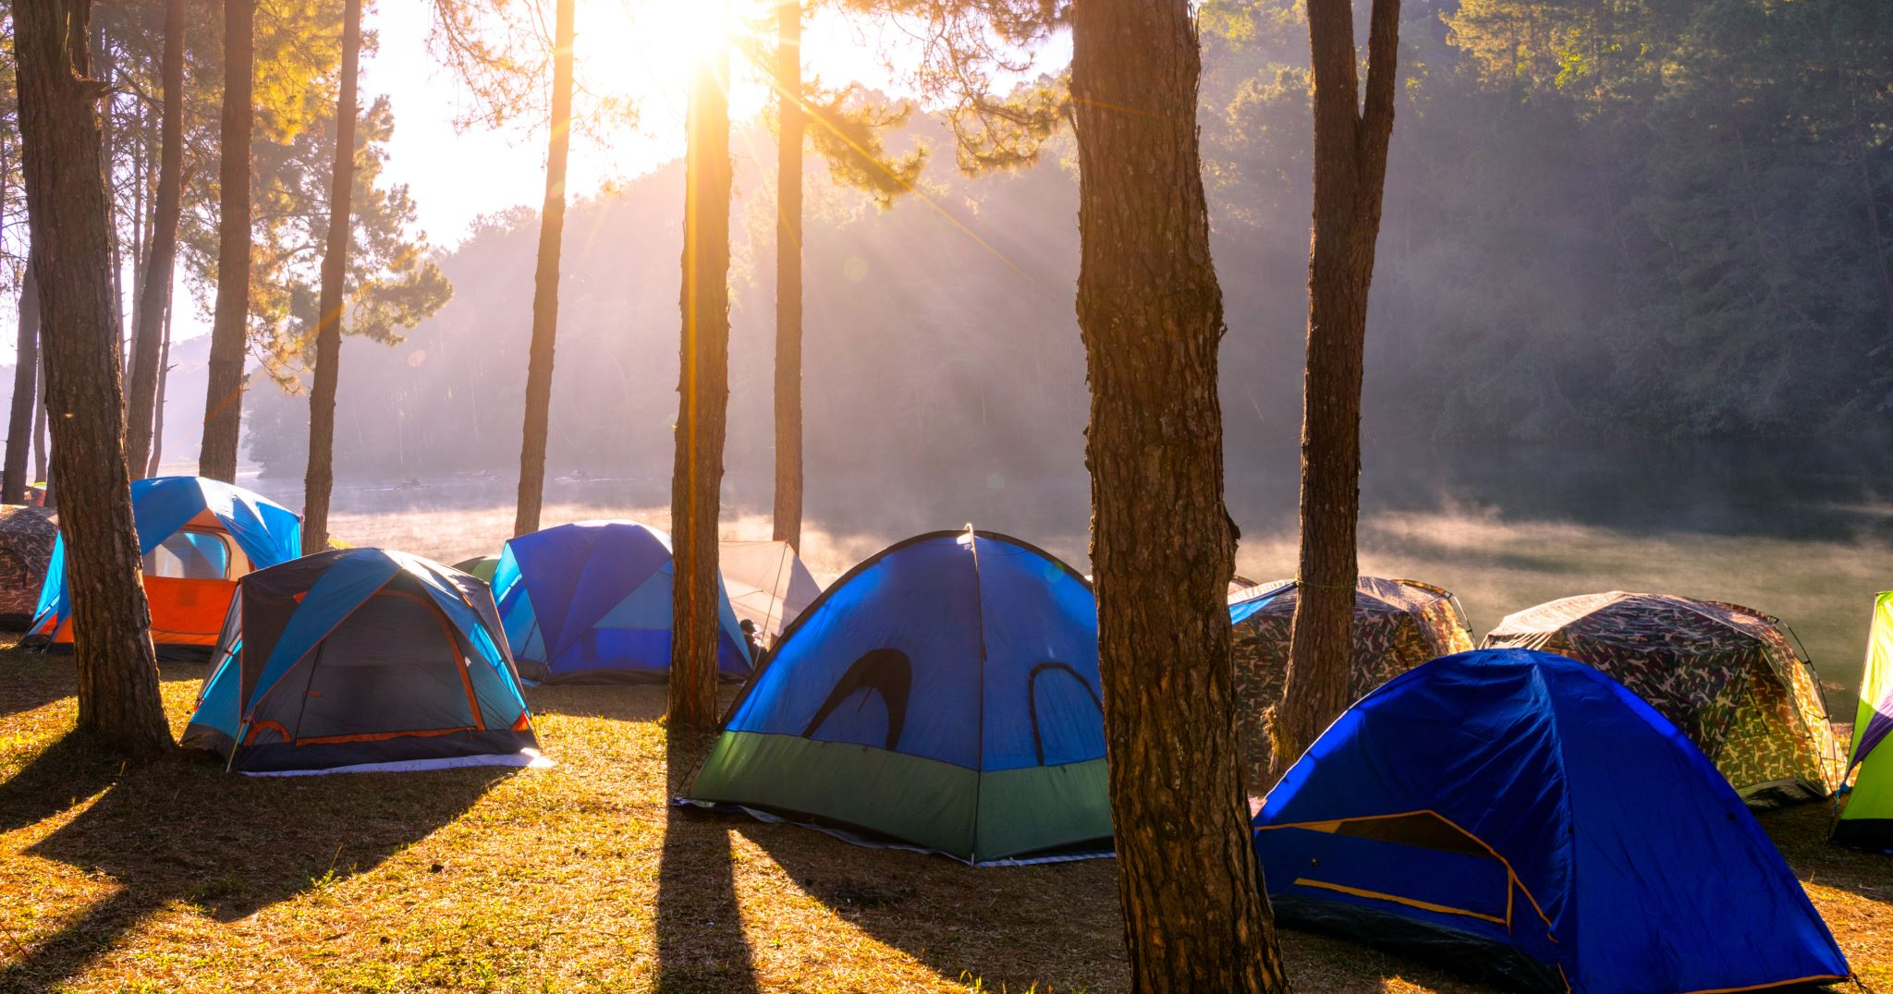
Camping
CE data from a similar timeframe (January to March) showed 25,678 people experiencing homelessness across the state. –Portland State University

Slide 7
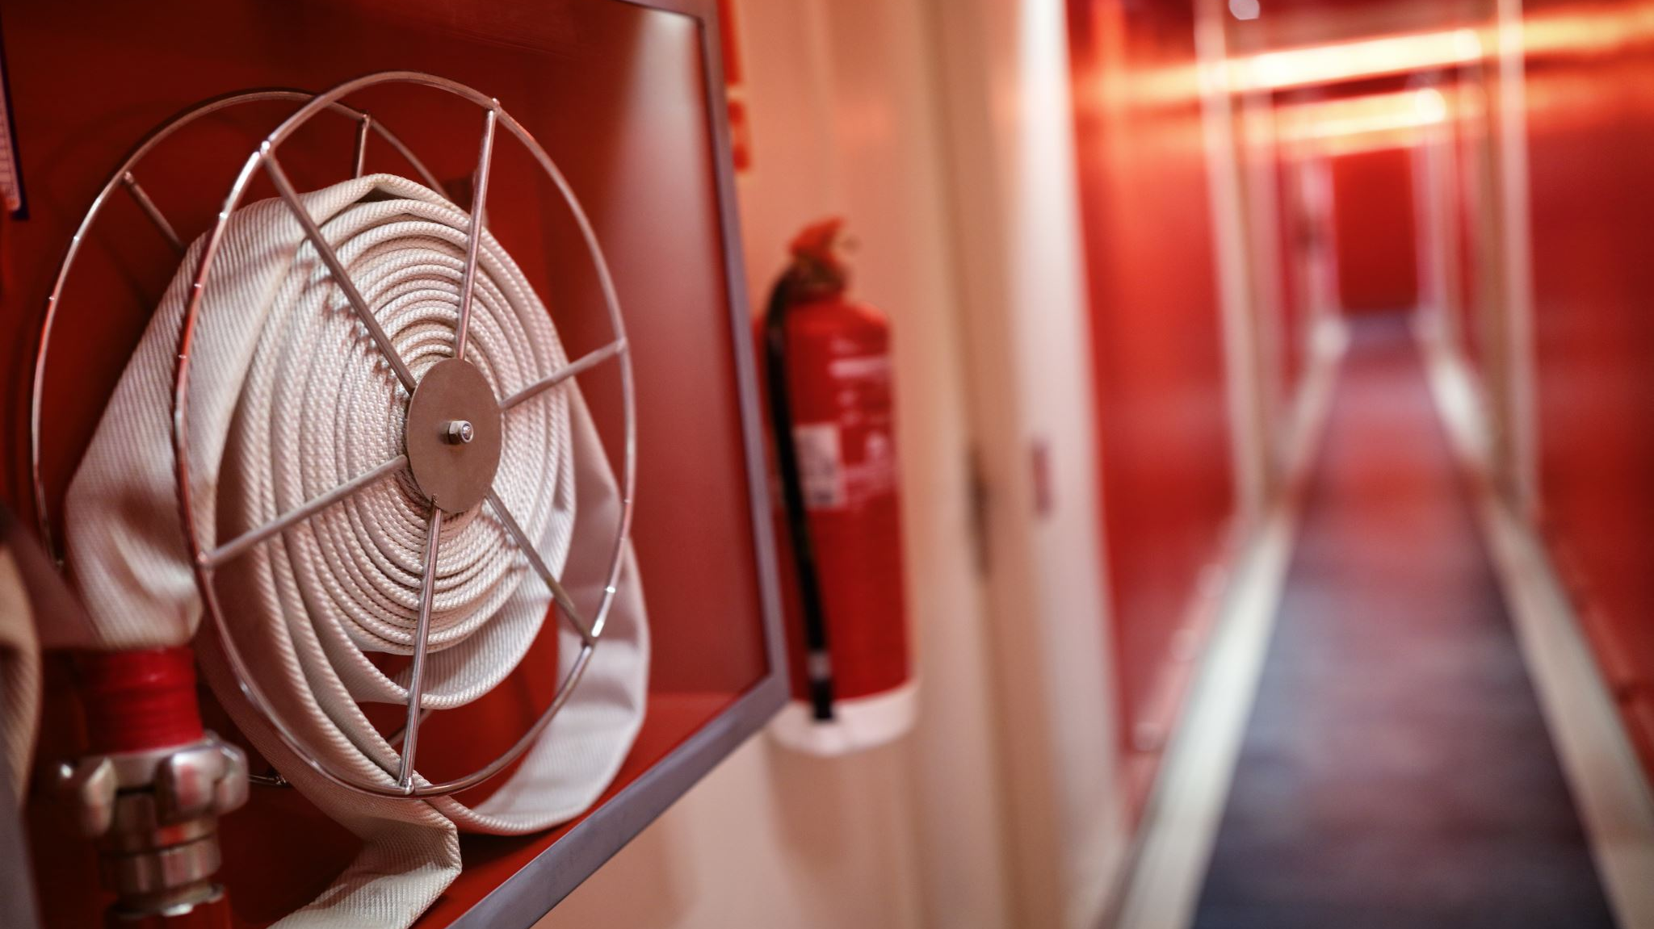
Cascadia Rising’s Exercise Scenario Document
Short-Term Sheltering Requirements
520,000 people
Short-Term Feeding & Hydration Needs
1,300,000 people
Electricity Restoration
1 – 3 months
Water & Wastewater Restoration
1 month – 1 year
Top-Priority Highways
6 – 12 months
Healthcare Facilities
18 months
Communities will be without working light switches, air conditioners, heaters, refrigerators, gas pumps, ATMs, stoves, and (gulp) electronics. Communications will be down. Toilets won’t flush, many roads will be damaged, and bridges destroyed. Grocery store shelves will sit empty. Pharmacies and doctor’s offices, if standing, will be triaging with minimal resources.

Slide 8

Stay or go?

Slide 9
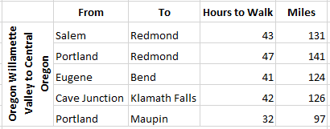
Stay or go?
Assuming the roads are passible by foot…

Slide 10
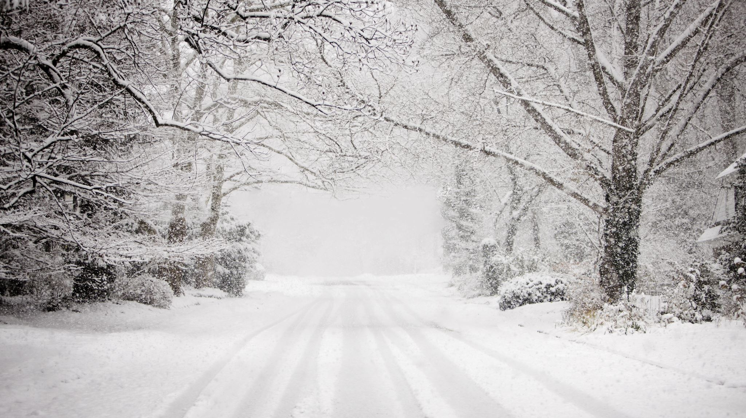
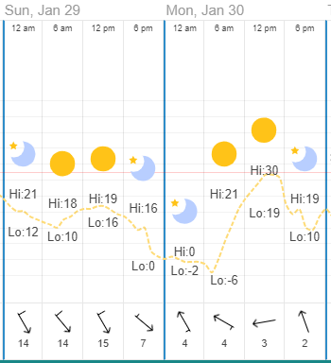
January 2023 low: -6°
Red Cross Hypothermia & Frostbite Resource

Slide 11

July 2023 High: 97°
“Nearly half of all fires in Portland now start in or near houseless camps—at least 2,048 last year, according to Portland Fire & Rescue data. It’s a remarkable number, given how five years ago, fires among unhoused Portlanders were hardly a blip. Today, there are an average of six a day.” – Willamette Week
Red Cross Extreme Heat Safety

Slide 12
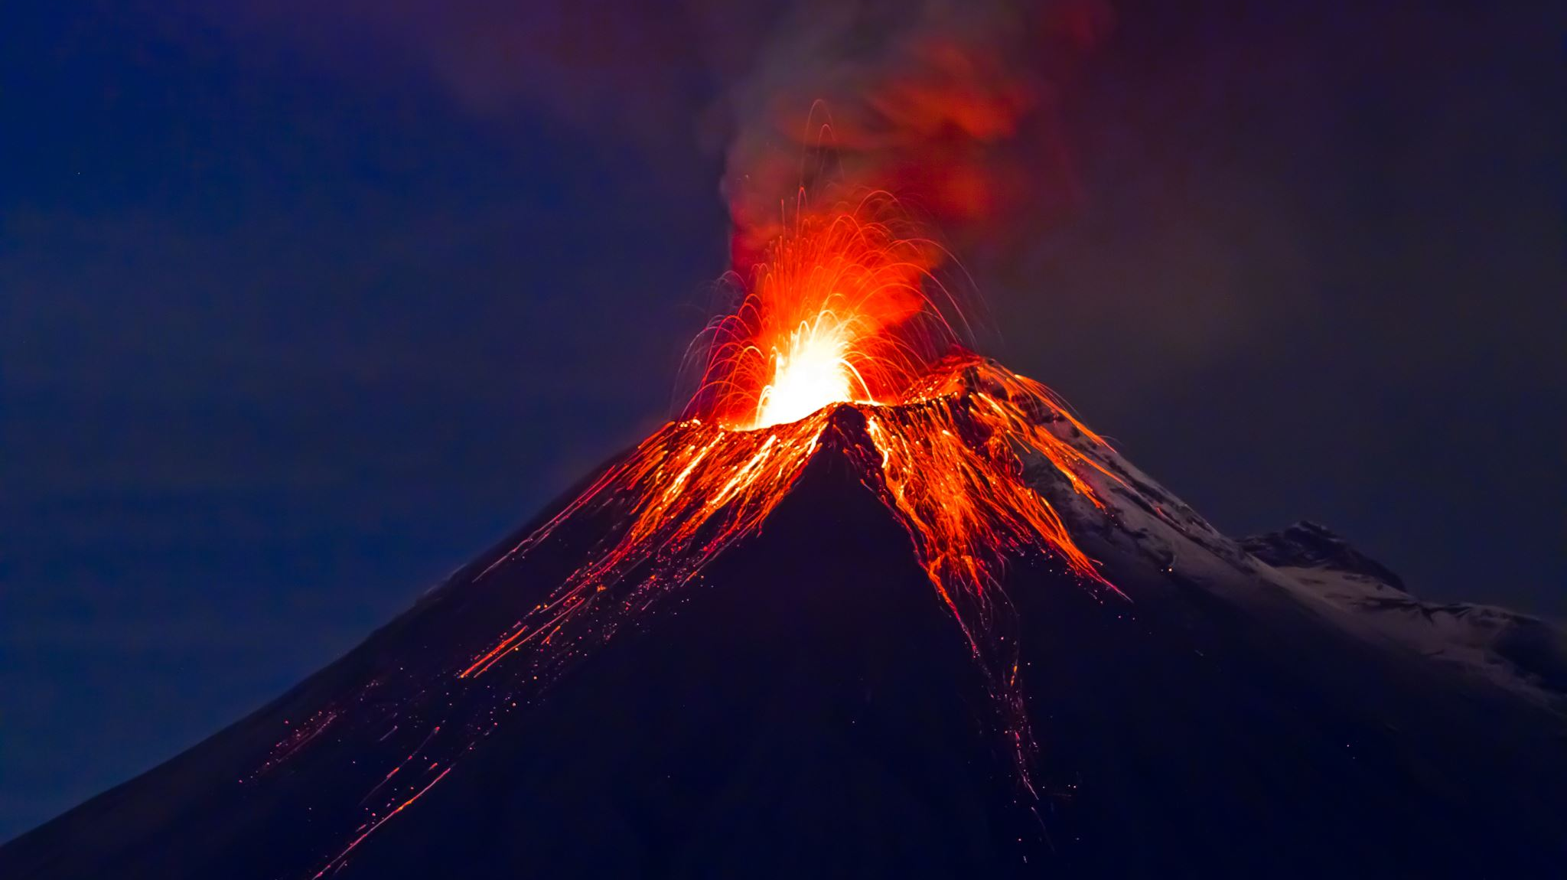
Volcanoes...
And
Earthquakes
"The growing frequency of climate change–related hazards such as wildfires, floods, landslides, and drought increases the chances that they will coincide in space and time with volcanic eruptions.“ – Portland State University

Slide 13

We could get lucky

Slide 14
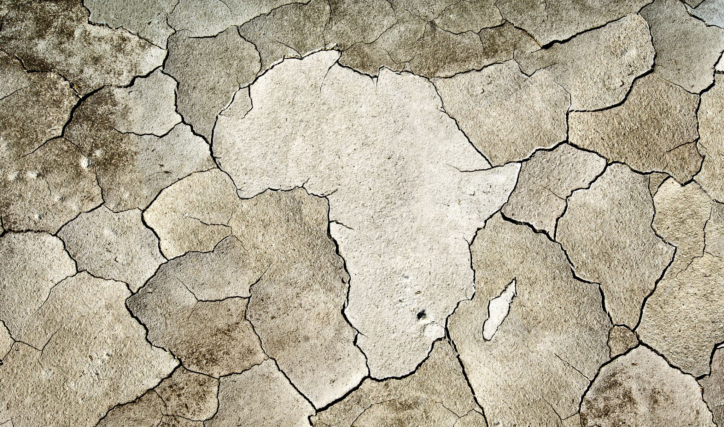
Co-Disasters
Liquefaction
Landslides
Co-Seismic Subsidence
Dam Failures
Possible Extreme Weather Events
Possible triggering of the San Andreas or a Cascade Range Volcano

Slide 15

Weight
&
Safety
Food
Water
Medical/First Aid
Sanitation
Sheltering

Slide 16

Who??
Who will you want to evacuate with?
Is anyone injured or disabled?
When the time comes, if you have planned to high-tail it out of the disaster zone and someone isn’t able to… what then?

Slide 17

Search and rescue
On average, more than 1,000 Search & Rescue (SAR) missions happen every year in Oregon. Lack of preparedness is a common denominator. – State of Oregon Newsroom

Slide 18

Medications & First aid

Slide 19
Situation
It’s Saturday evening and you’ve just returned from vacation. You are wearing one of your last three pairs of daily-use, disposable contacts. The new set is due to arrive on Monday. glasses that you use as backup are packed in your suitcase… which the airline has lost. They’ll call you as soon as they locate the suitcase, so you head home. The earthquake strikes at 2:00 am the next morning.
Communications are down. The airline won’t be able to call you, even if they somehow miraculously find your suitcase… not that anyone is looking now. Your only pair of glasses isn’t going to find their way home anytime soon.
Transportation routes are severely damaged, fuel is not available, and delivery workers are at home taking care of their loved ones. You won’t be receiving those contacts anytime soon, either.
With only two pairs of contacts left, you will try to stretch their usage, but they are unlikely to last the week. And the world around you is nearly unrecognizable now. Not being able to see well in a post-disaster landscape will make the aftermath much more difficult to maneuver.
Preparedness Action
have an extra 30-day supply of contacts and a spare pair of glasses.

Slide 20
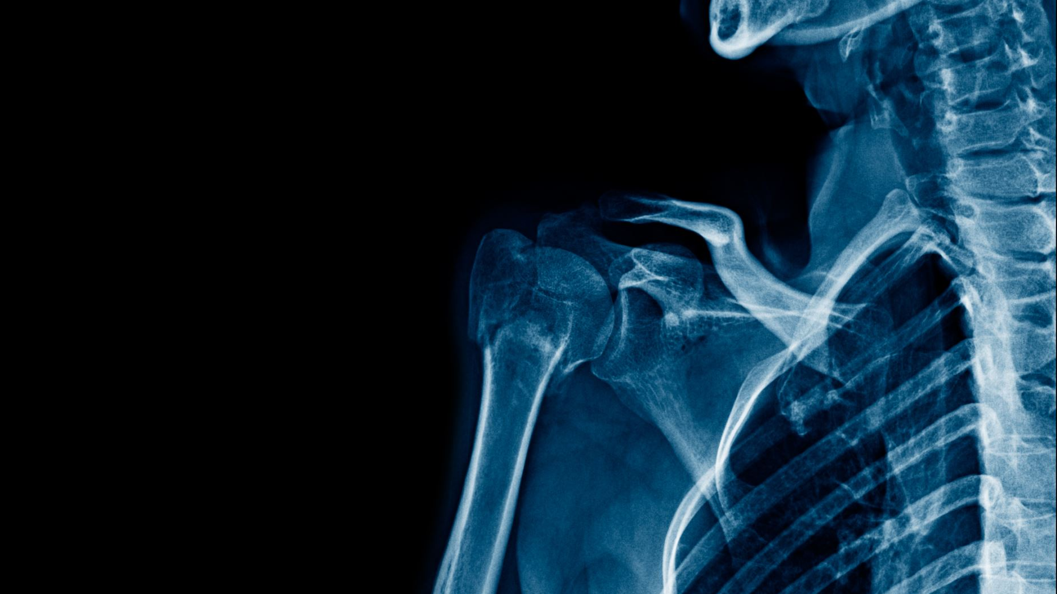
Head, shoulders, knees & toes
Headaches
Ear Pain
Dry Eyes, Vision
Soar Throat
Cough
Congestion
Blood Pressure
Insulin & Cooling Water Wallet
Heart Medications
Lung Medications (Inhaler)
Anti-Diarrhea, Laxatives, Pepto
Fever Reducers
First Aid/CPR Certifications & Supplies
Take a CERT class!
Prescriptions (30-day supply)
Covid Test Kits
Vitamins
Antihistamine Medications
Biggest Fish First!

Slide 21
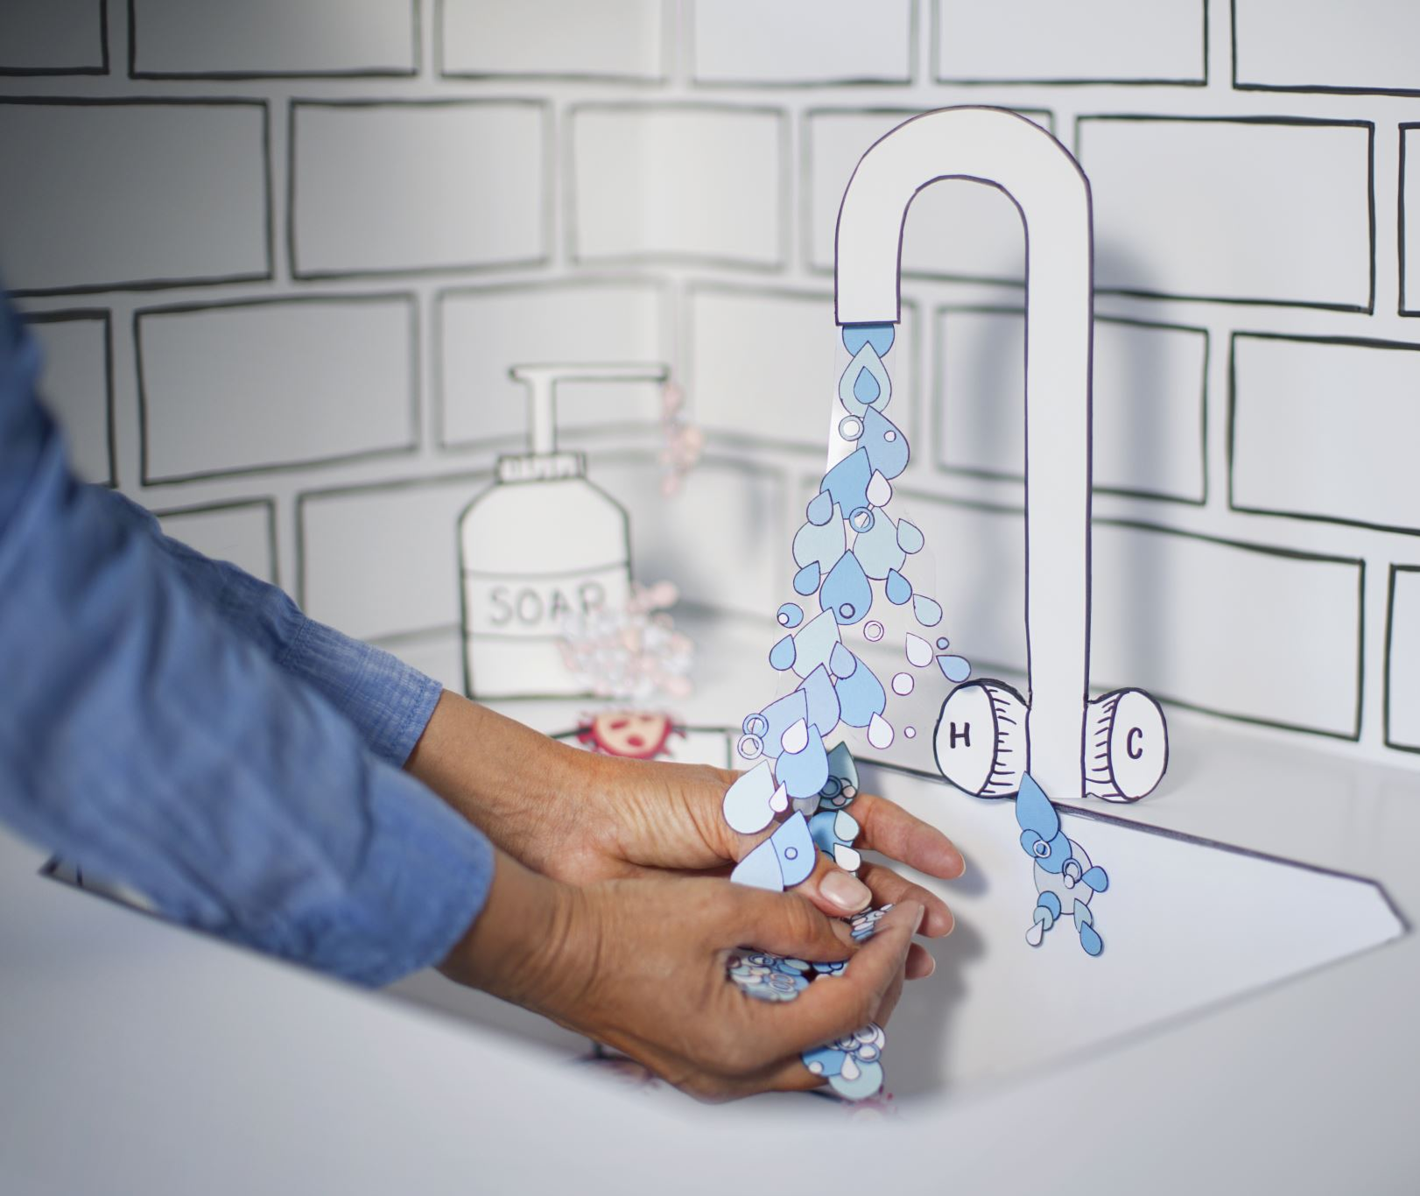
Sanitation

Slide 22
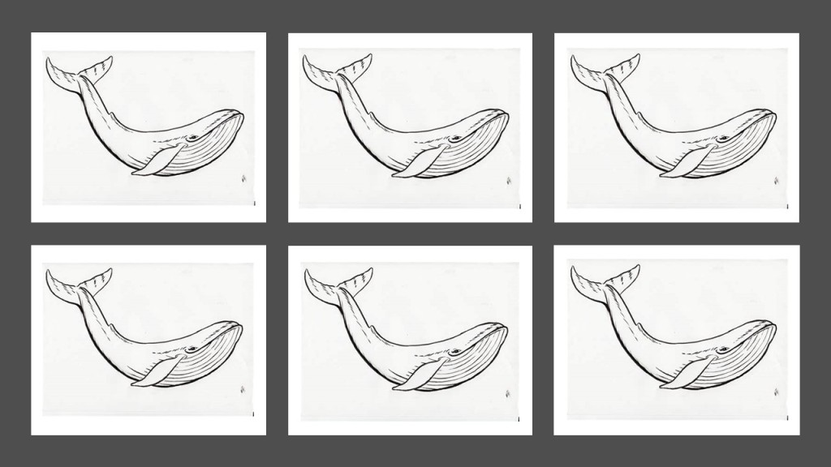
Twin Bucket System
1,000 tons of feces… every single day

Slide 23
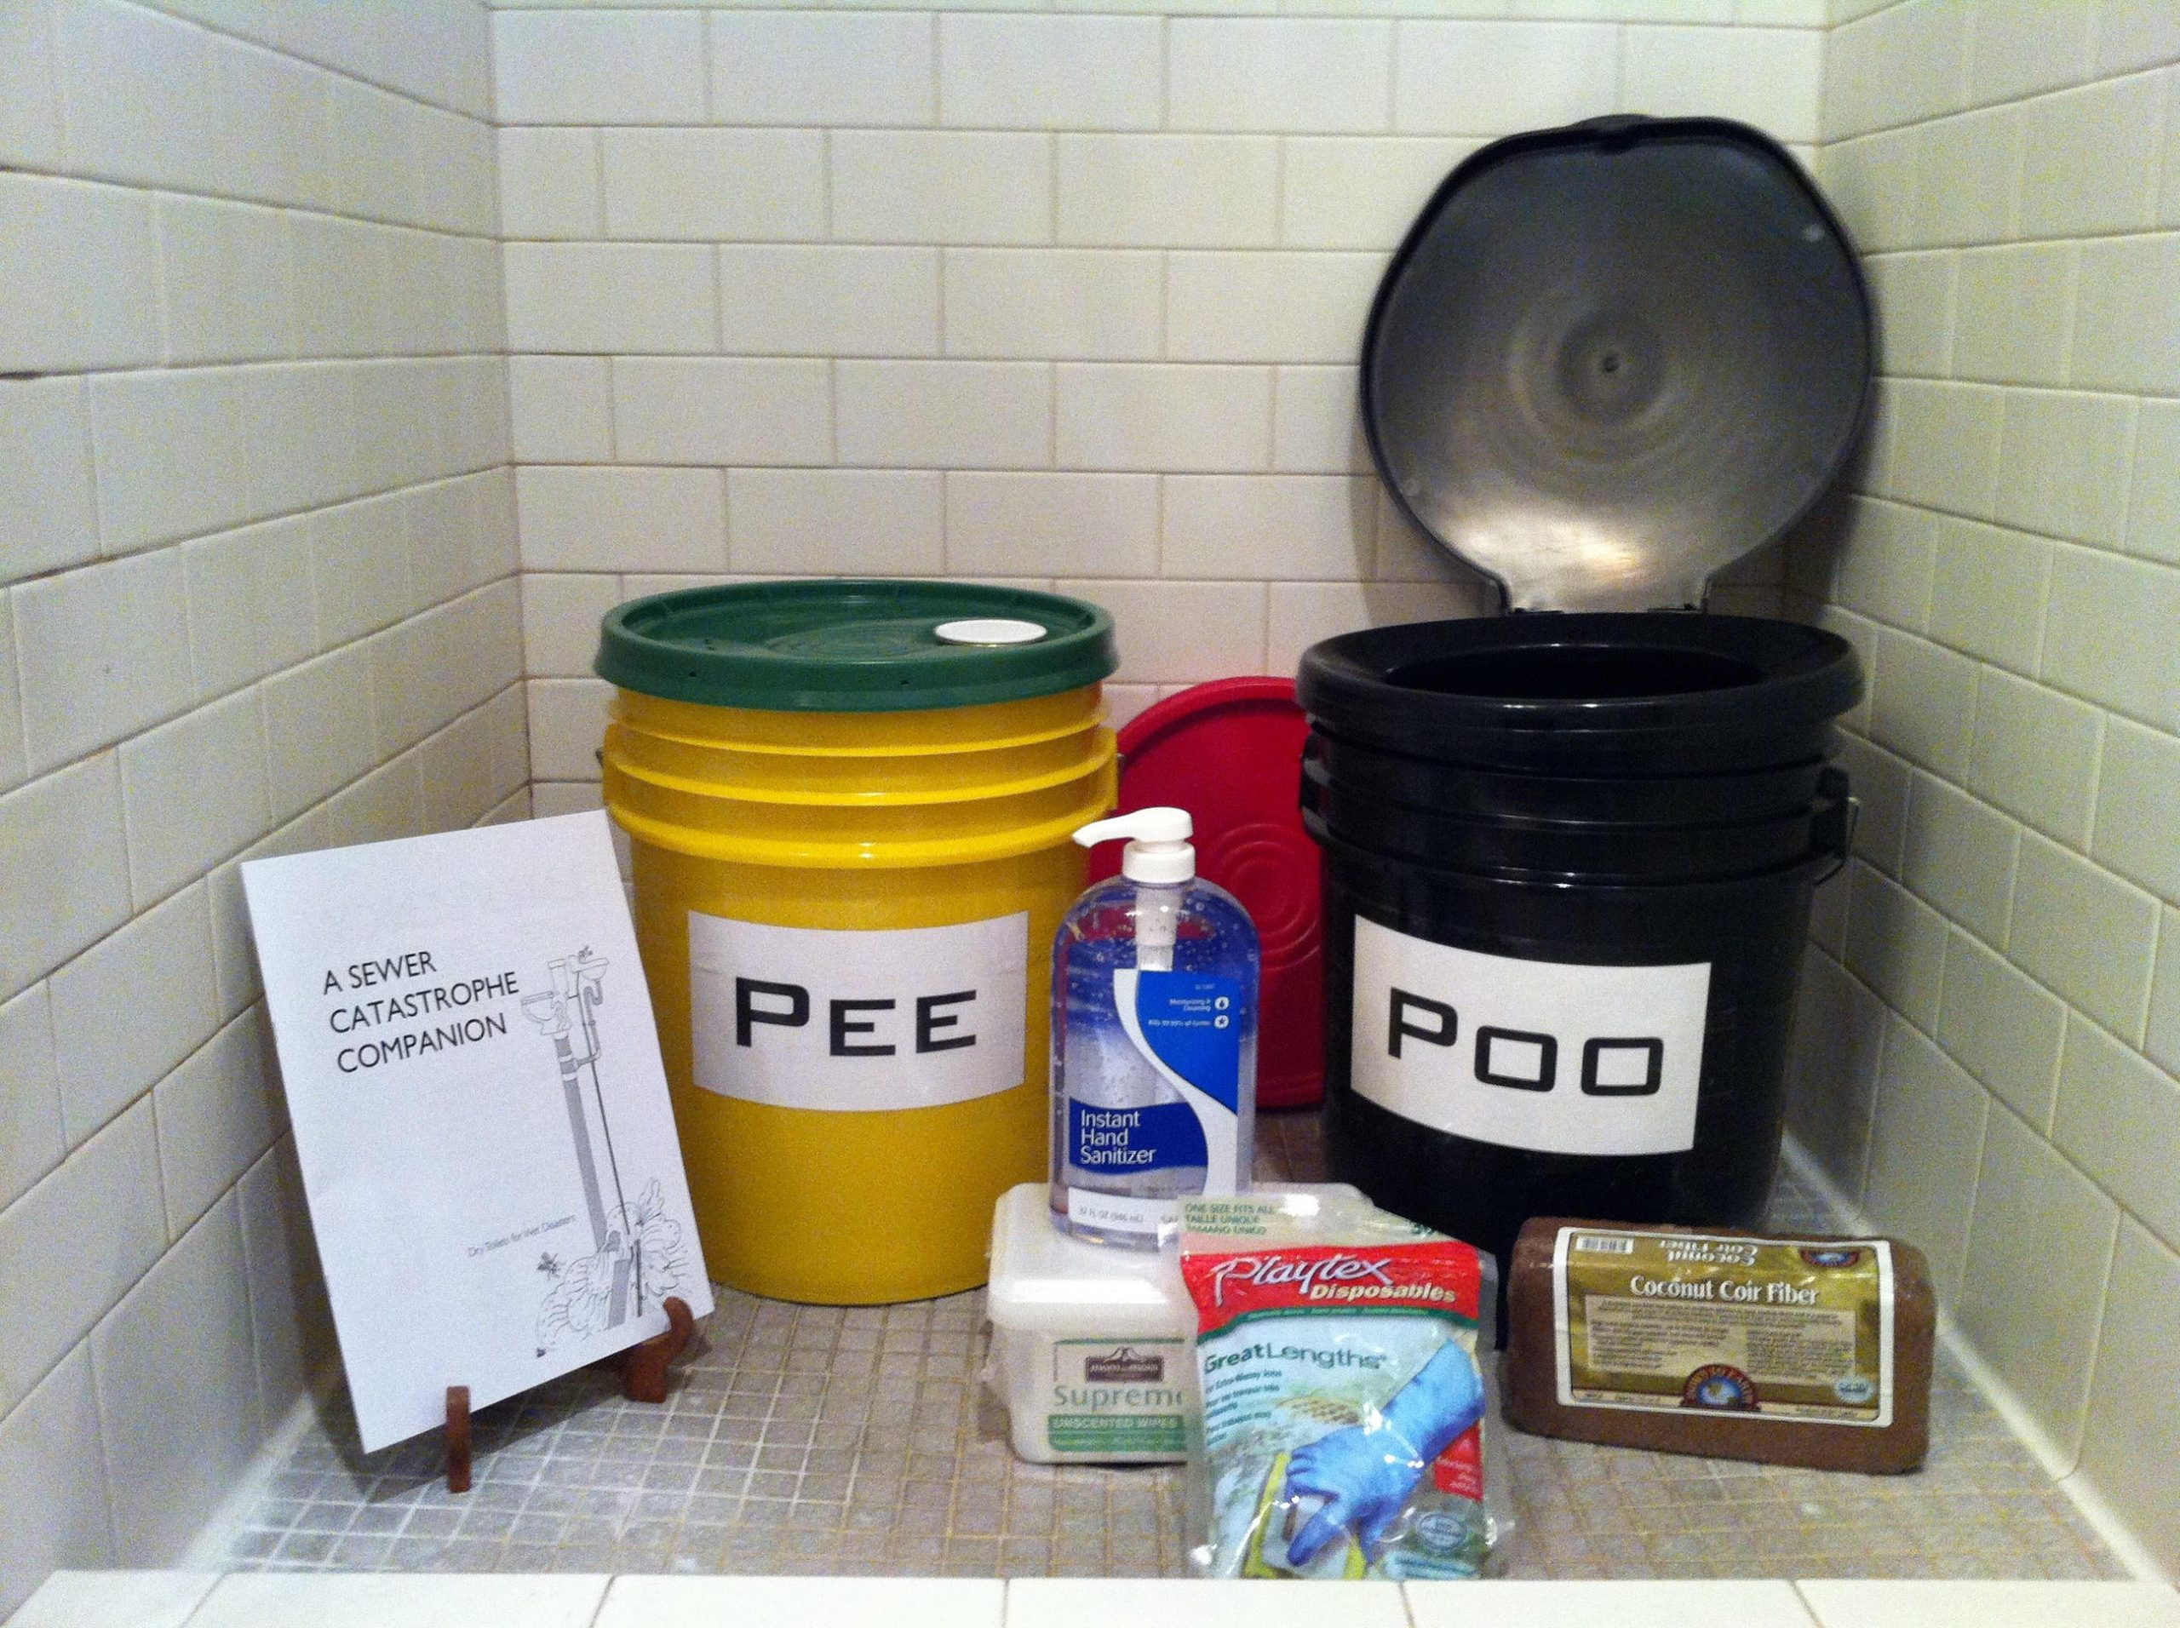
Twin Bucket System
“Plastic buckets – 5 or 6-gallon size; 2 buckets for 3-4 people for 3 days; a dozen buckets for a month.”
https://www.phlush.org/earthquake-sanitation-risks/
A much longer recovery time for sewer and wastewater systems than for drinking water systems.
For Portland, controlling threats to public health and routing sewage away from population will take an estimated 6 to 12 months
Repairing collection systems that convey sewage to wastewater treatment plans will take 1-3 years.

Slide 24
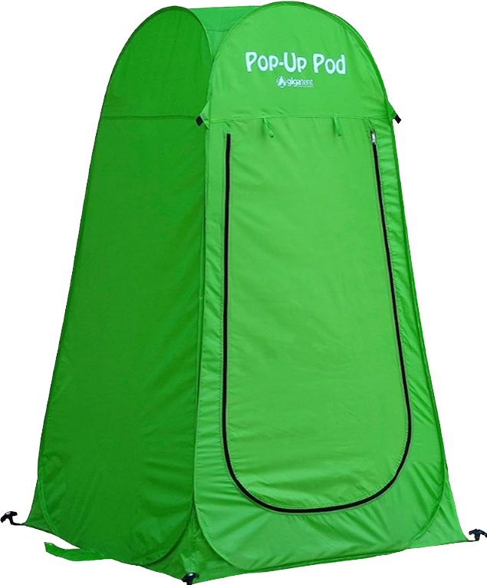
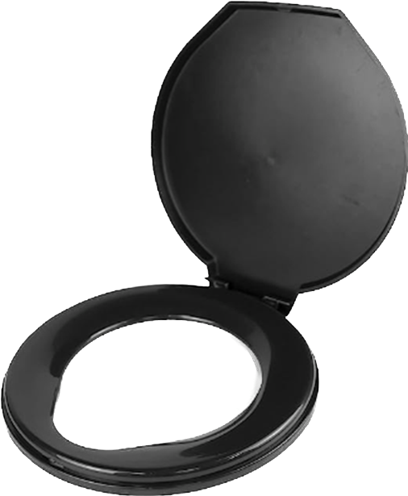
Twin Bucket System
Print-Out

Slide 25
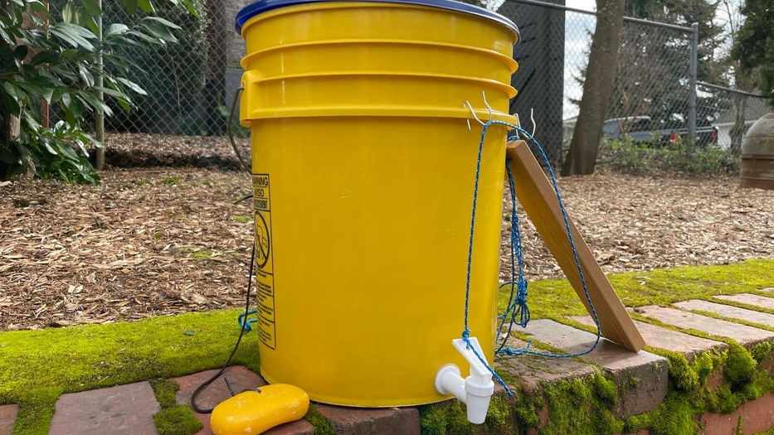
https://www.instructables.com/Easy-Build-Handwashing-Station-With-Videos/

Slide 26

Soap, Disinfectants, sanitizers, gloves, masks, garbage bags, wipes…extra water!

