Slide 1
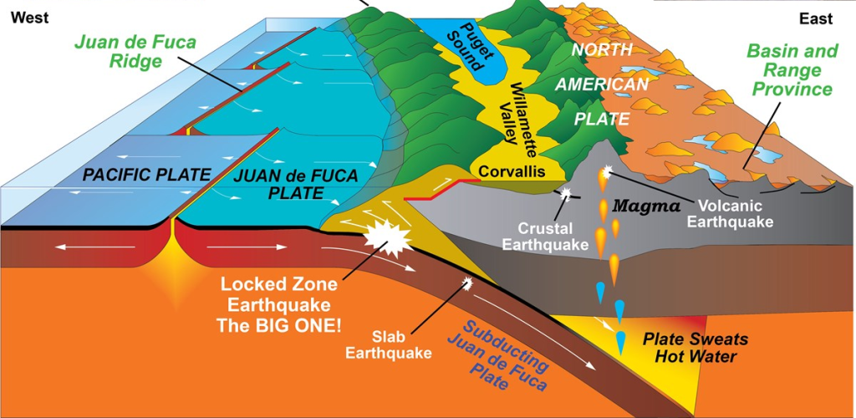
Cascadia Megathrust Fault
Expected Impacts, Seasons, Food-Ready
Bridget Good
  503-801-6100
  Bridget.Shannon.Good@gmail.com
Image Credit: National Park Service

Slide 2
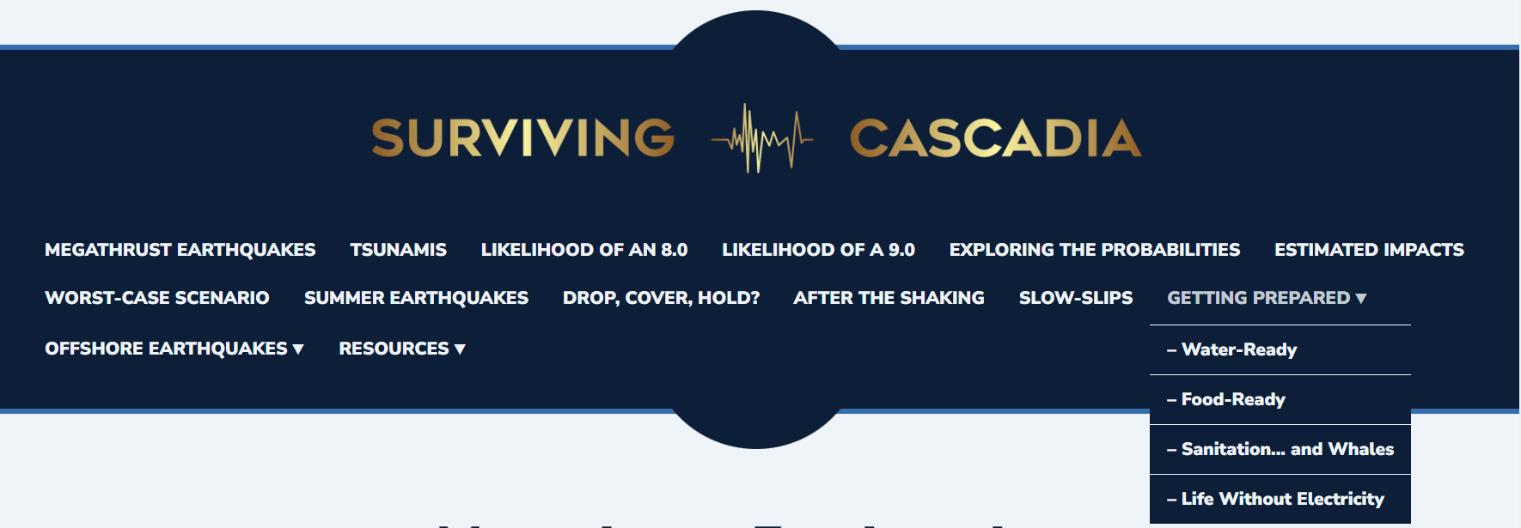

Slide 3
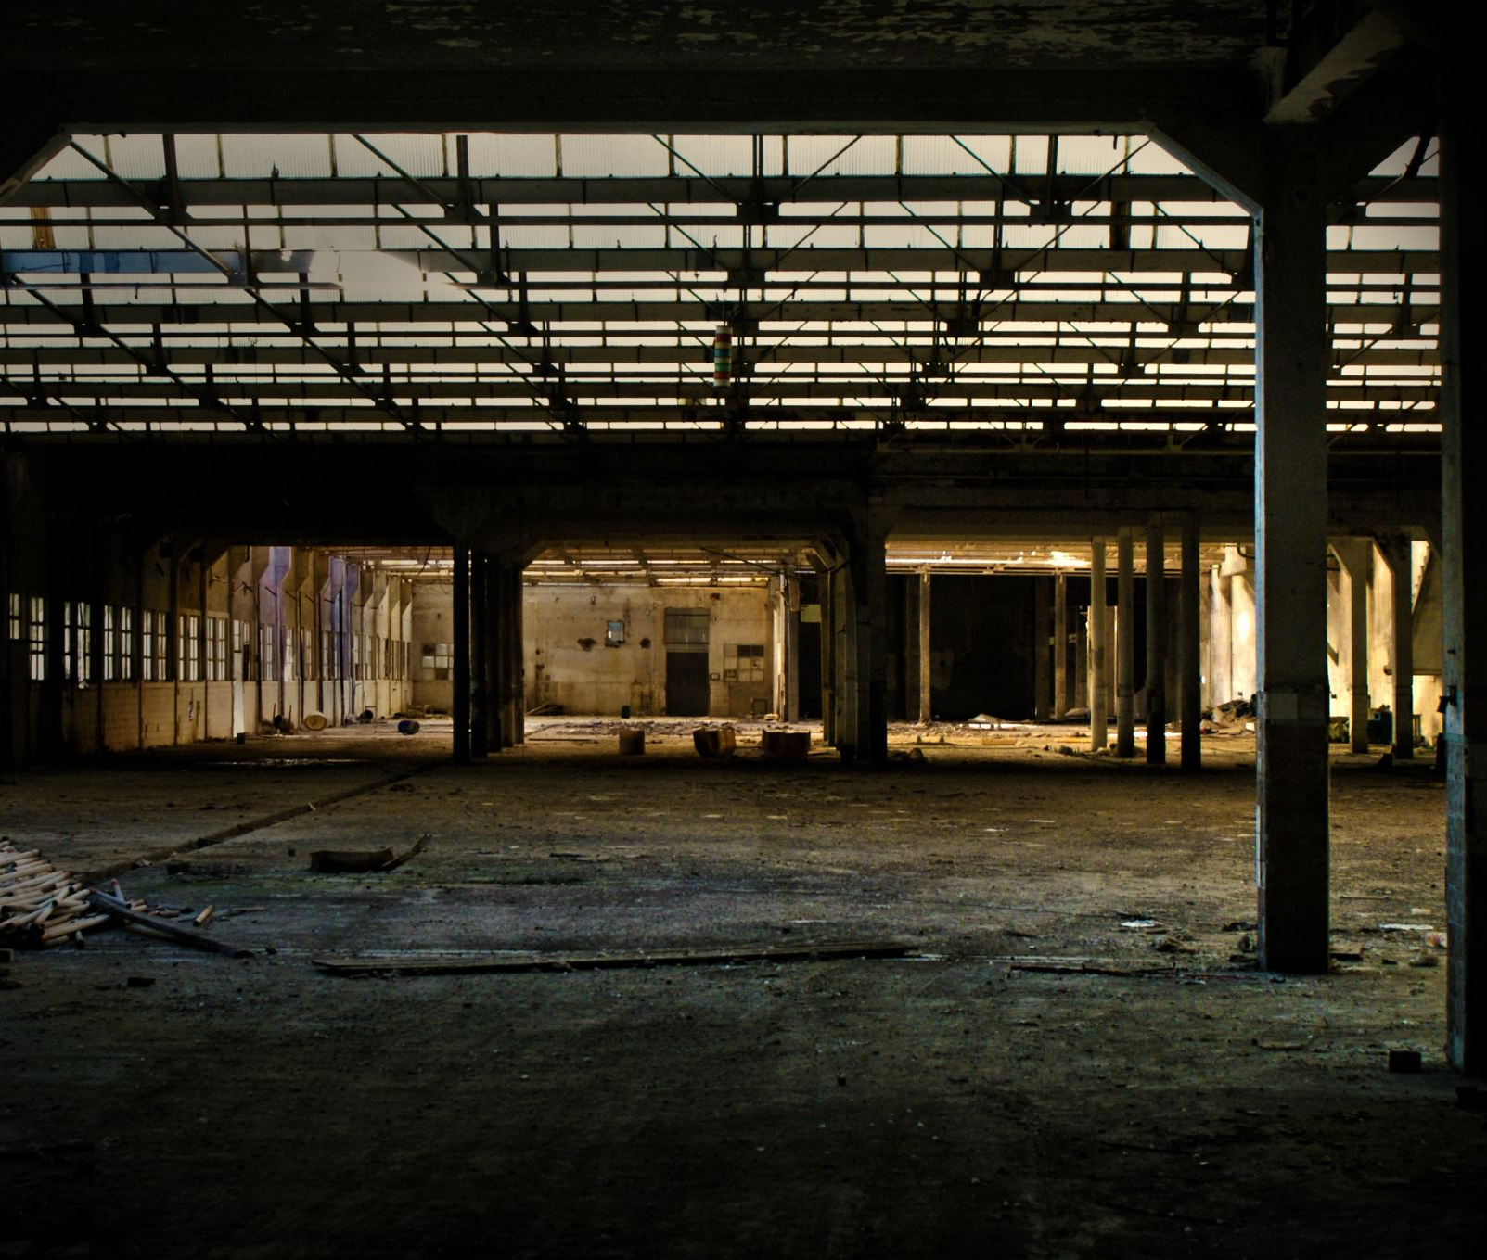
Expected Impacts
24,000 buildings completely destroyed
85,000 buildings with extensive damage
$32 billion in economic losses
27,600 displaced households
10 million tons of debris (1 million dump truck loads)
https://www.oregon.gov/oem/Documents/Oregon_Resilience_Plan_Executive_Summary.pdf

Slide 4
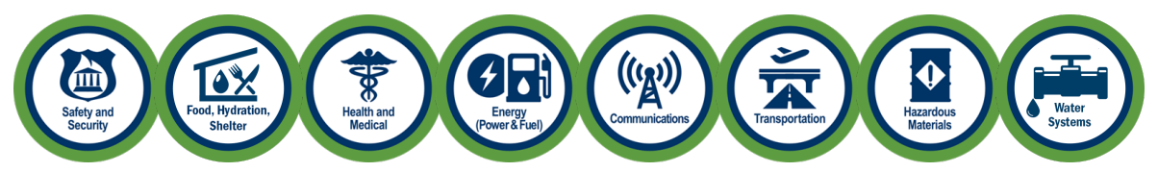


Slide 5
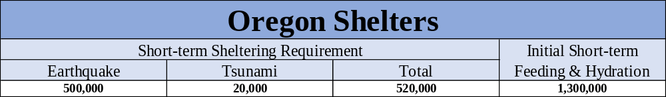
Cascadia Rising Exercise Scenario Document

Slide 6

Electricity
Electric facilities in the I-5 corridor may suffer considerable damage to generation plants, and many distribution circuits and substations may fail, resulting in a loss of over half of the systems load capacity. When electric facilities fail, power is rerouted to neighboring segments of the network. Protective relays may sense the overload and shut down. The loss of load capacity from each switch may cause cascading blackouts extending much further than the impacted area. Within minutes of the initial shaking, vast regions of Washington and Oregon may experience a complete blackout.
Cascadia Rising Exercise Scenario Document
Time to restore: 1 – 3 months
Oregon Resilience Plan

Slide 7
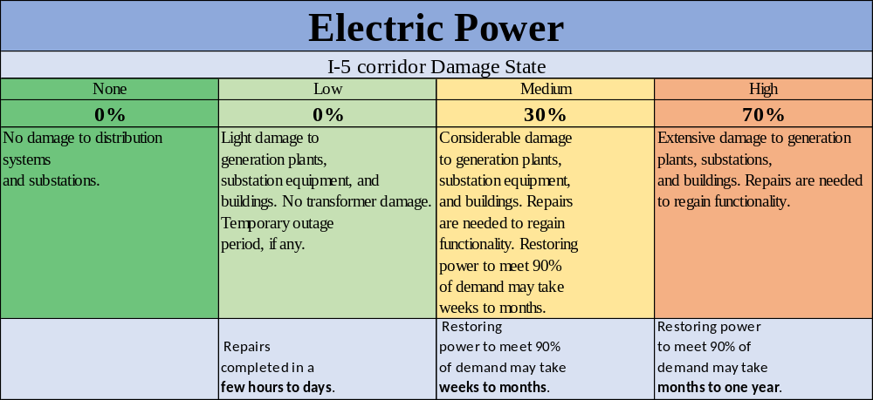
Cascadia Rising Exercise Scenario Document

Slide 8
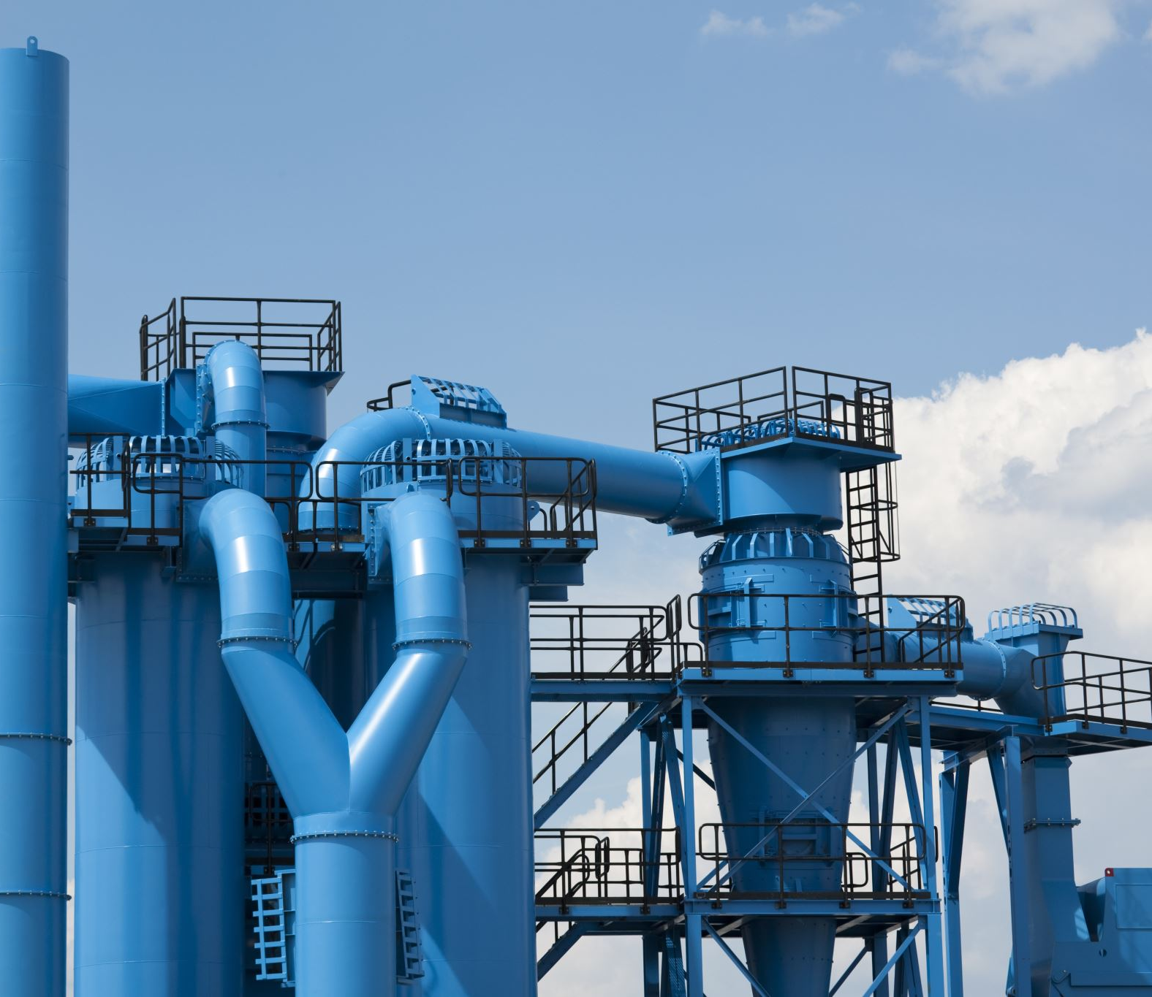
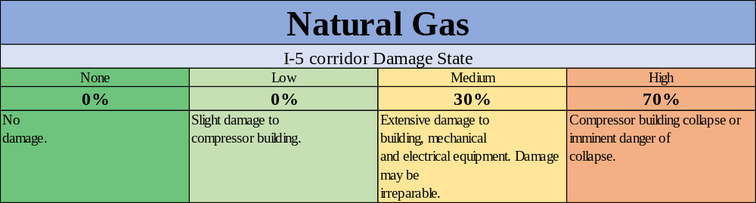
Restoration timelines for natural gas depend on location and road conditions. Some inland areas may have services restored in days.
Cascadia Rising Exercise Scenario Document

Slide 9

water
Widespread sewage release and sewer-line backups may result in a shutdown of the system until repairs are completed. Restoration timelines could be three weeks to seven months, with the greatest damage and longest restoration times near the coastline. Complete restoration of some damaged wastewater systems could take several years.
Cascadia Rising Exercise Scenario Document
Time to restore: 1 month – 1 year
Oregon Resilience Plan

Slide 10
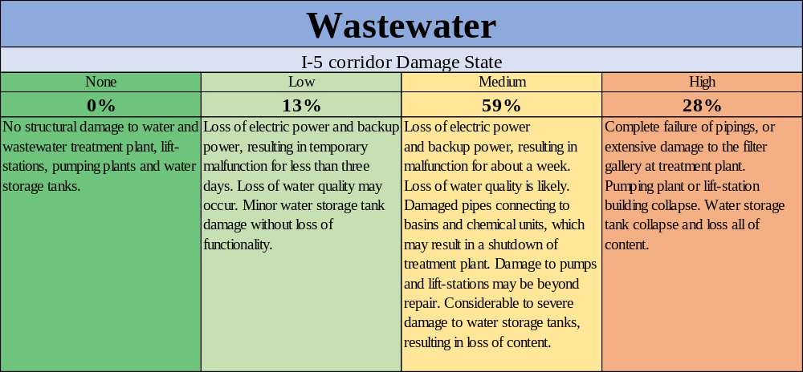

Slide 11
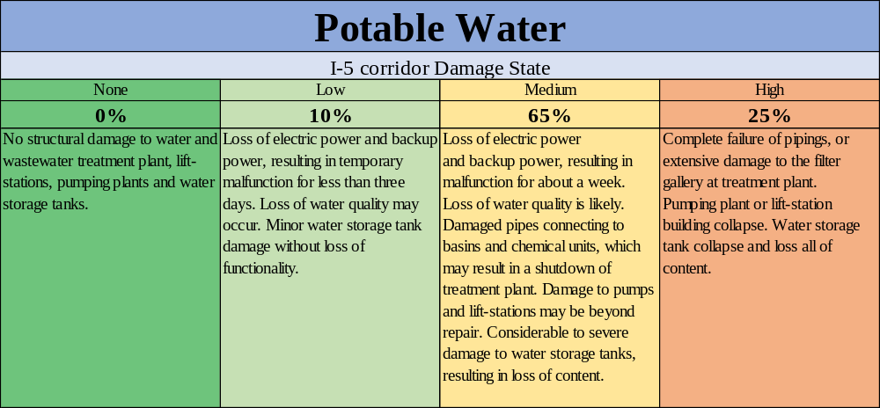

Slide 12
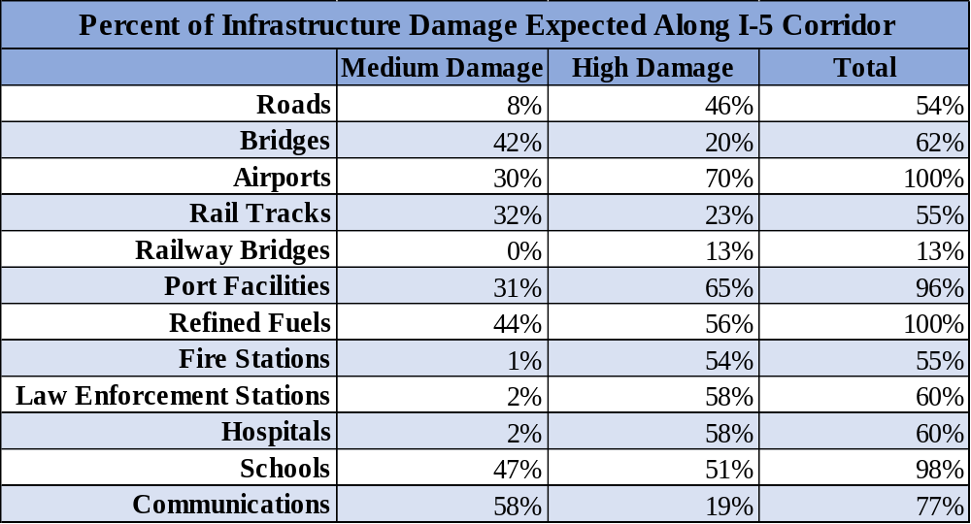
Cascadia Rising’s Exercise Scenario Document
Oregon Emergency Management, January 2015
Top-Priority Highways: 6 – 12 months
Healthcare Facilities: 18 months

Slide 13
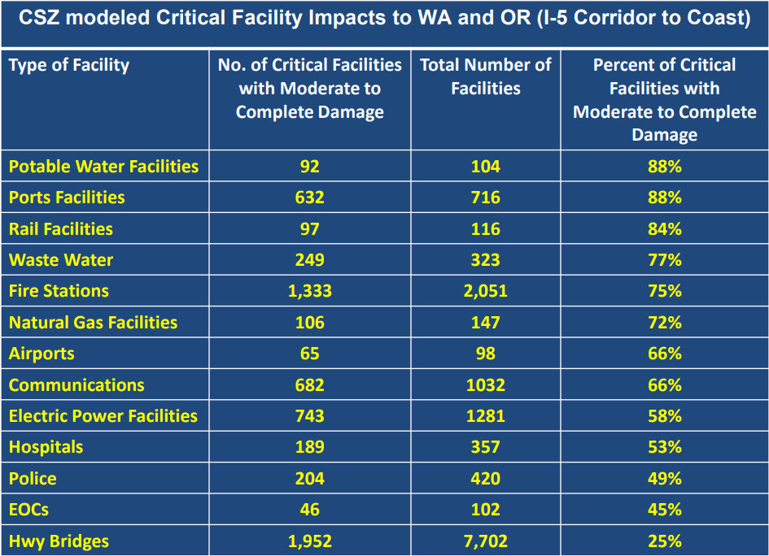
FEMA Region 10 Cascadia Subduction Zone (CSZ): Earthquake and Tsunami Damage Impacts Overview

Slide 14
Detroit Dam Failure
Total failure of the Detroit Dam, with a full reservoir, would cause the smaller Big Cliff Dam to fail also and would inundate Gates, Mill City, Stayton, Aumsville, Turner and Jefferson as well as cause significant portions of Salem and Keizer to be flooded.
Marion County EOP
US Army Corps of Engineers: Detroit Dam IRRM Pool Restriction

Slide 15

Sanitation… and Whales
OSSPAC has found that Oregon’s population living within the probable earthquake-impact area will produce at least 1,000 tons of feces… every single day.
OSSPAC Mass Care and Mass Displacement after a Cascadia Subduction Zone Earthquake

Slide 16
2-Weeks-Ready
There are many organizations recommending that you get 2-Weeks-Ready. As stated on the Surviving Cascadia Water page, the American Red Cross Cascades Region, the Oregon Office of Emergency Management, and the Washington Emergency Management Division ask that each home store 14 gallons of water per person (1 gallon of water/person/day for 2 weeks). The Central U.S. Earthquake Consortium, the City of Salem, and Oregon’s Lane County also have fabulous 2-weeks-ready planning guides and challenges to help get you ready.

Slide 17

Summer Earthquakes

Slide 18

Summer Benefits
Camping weather for those who are displaced, including pets
Fewer viruses circulating on day 1
Easier to keep things sanitary (less mud, mold, etc.)
Dry fuel for building fires
Dry paths for easier, safer evacuation routes
Children not in school
Local food to harvest like fresh blackberries
Warm temperatures for sanitation activities
Sunlight stretching several hours longer than in winter
Fewer people struggling with seasonal affective disorder (SAD)
Clothing Dries Quicker

Slide 19
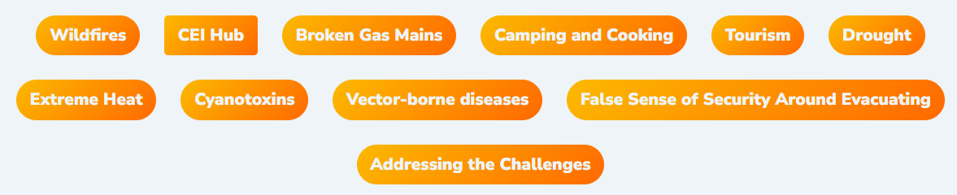


Slide 20

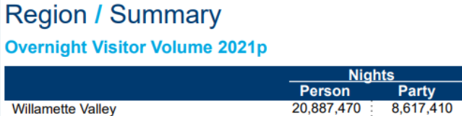
Tourism
Travel Oregon

Slide 21

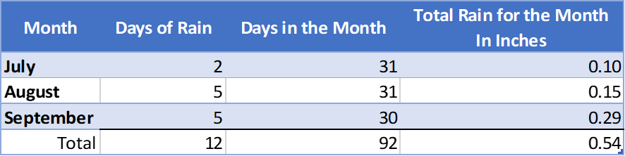
https://www.weather.gov/wrh/climate

Slide 22
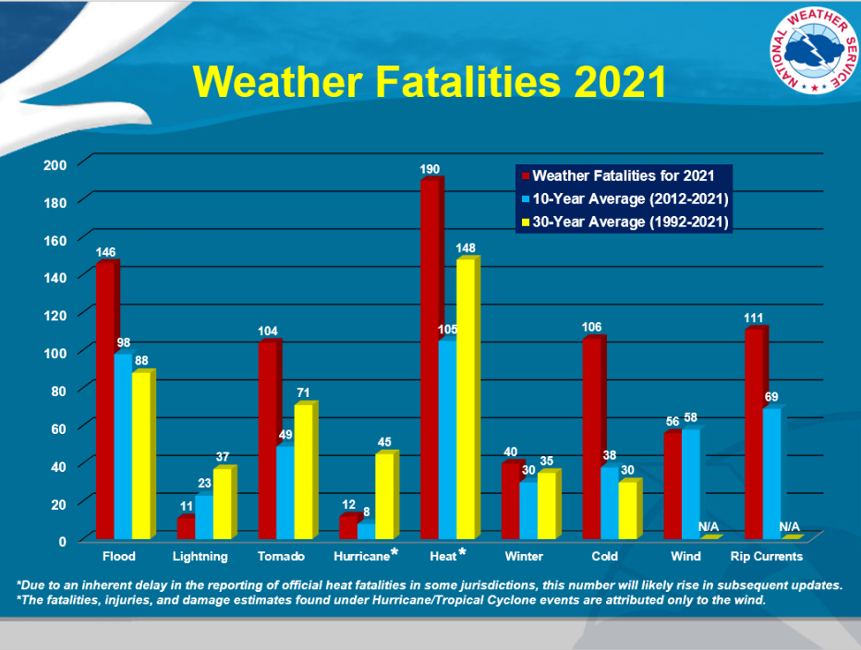
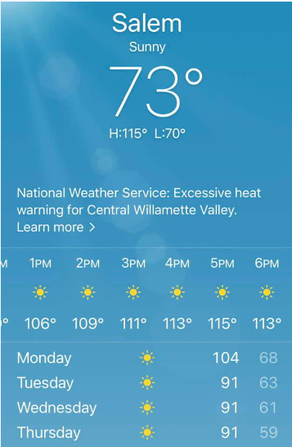
https://www.weather.gov/hazstat/

Slide 23
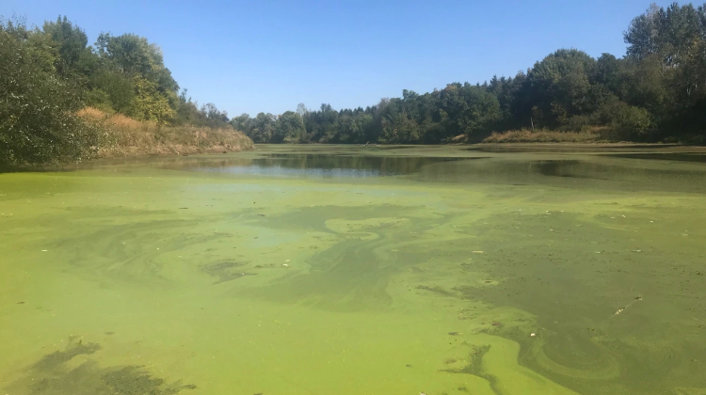
Cyanotoxins

Slide 24

Food
Types
Calories
Weight of storing
Expiration dates
Water needs

Slide 25
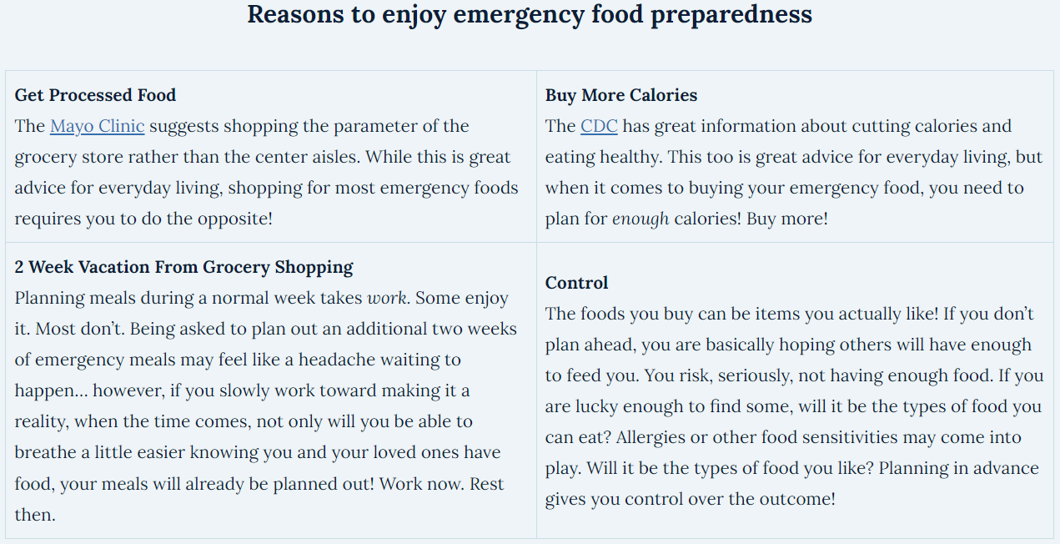

Slide 26

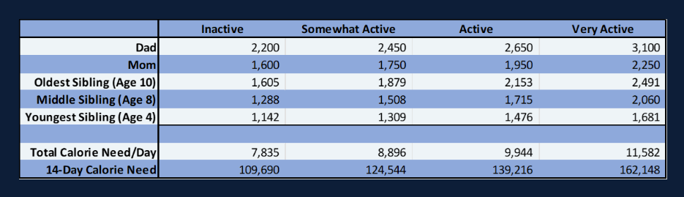

Slide 27
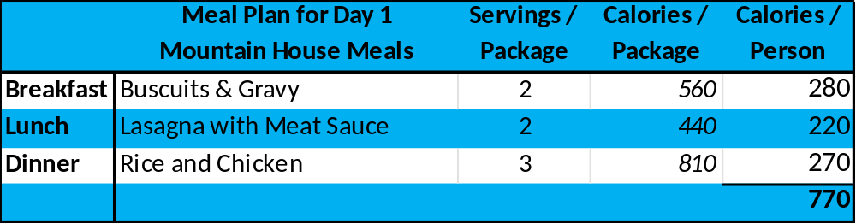
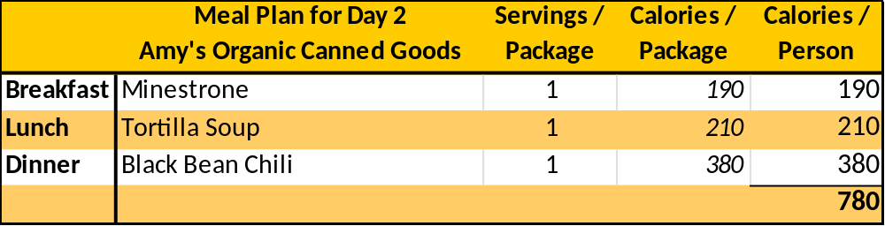
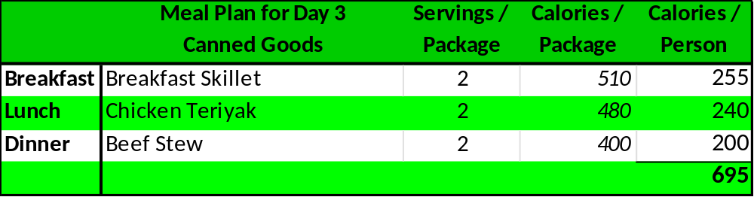
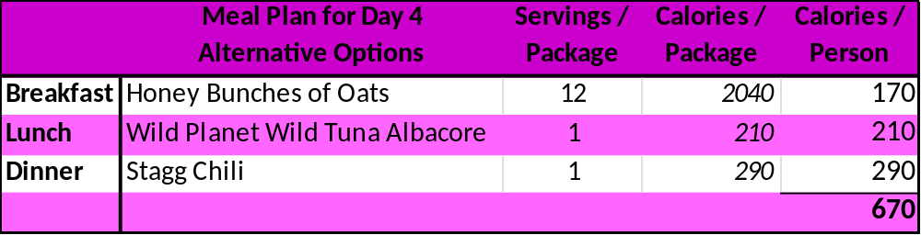
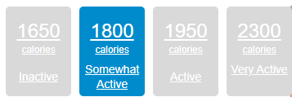

Slide 28

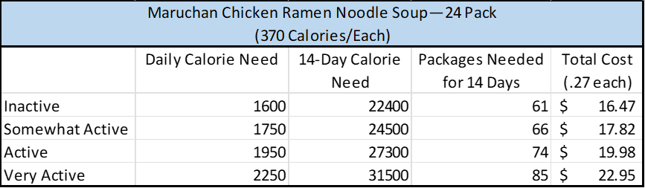

Slide 29

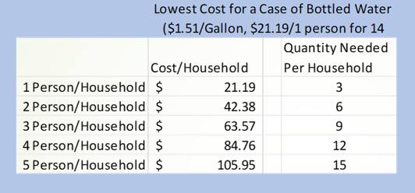
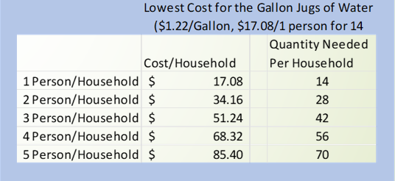

Slide 30
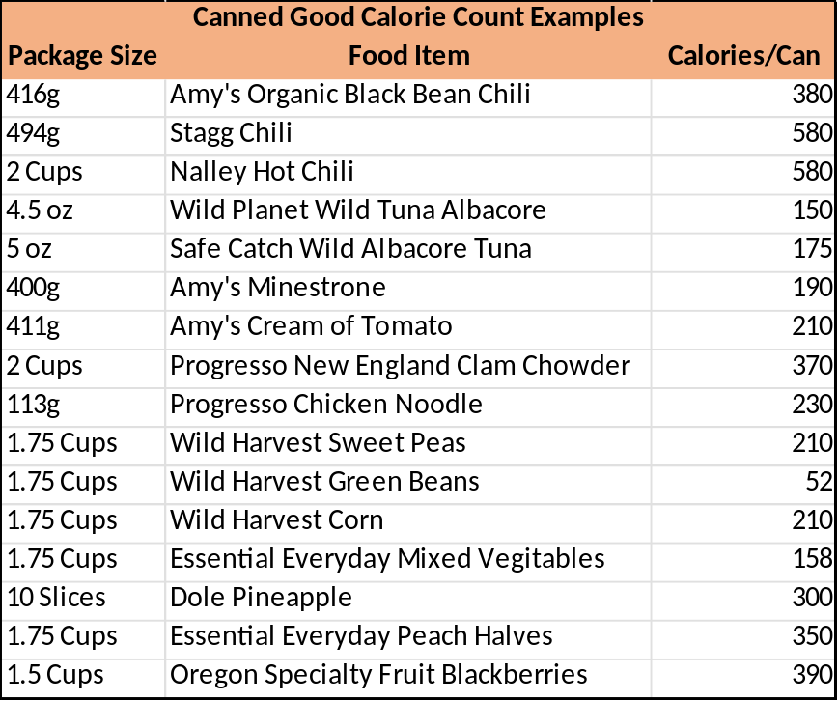
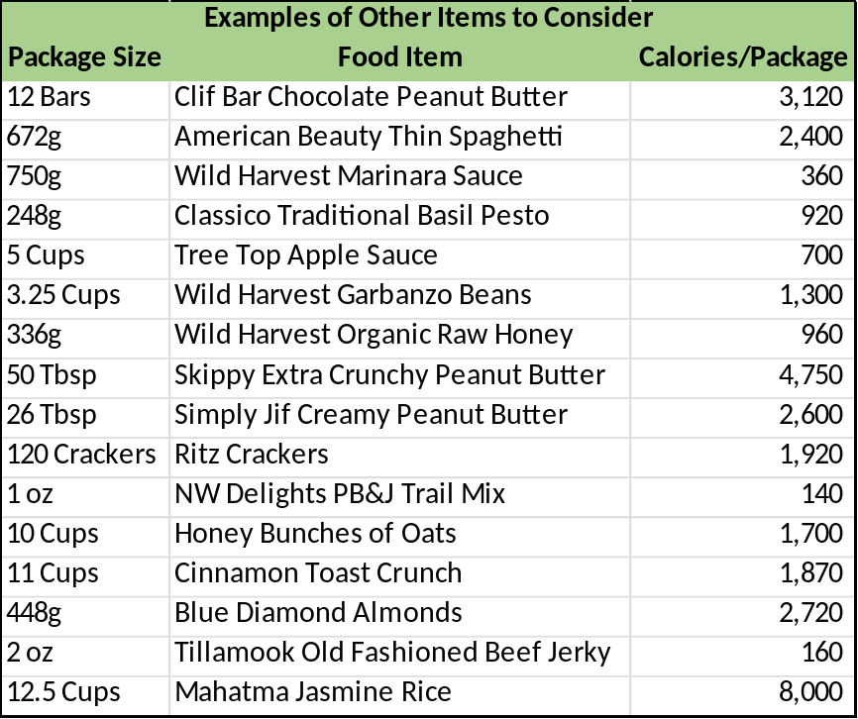
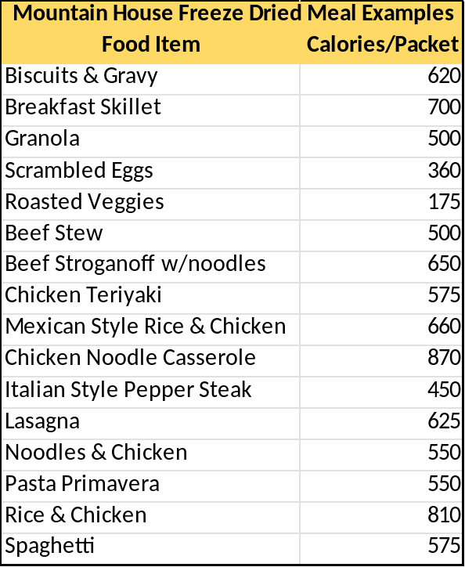

Slide 31

Questions?

