Slide 1
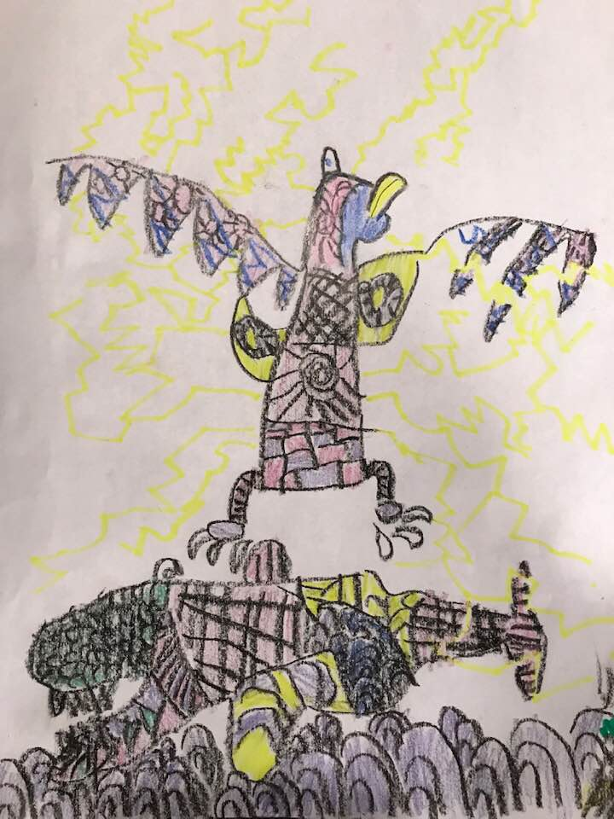
Creekside Neighborhood
Preparedness Get-togethers

Slide 2

Brief Introduction

Slide 3
Brief Introduction
Bridget Good
  503-801-6100
  Bridget.Shannon.Good@gmail.com
  SurvivingCascadia.com (CSZ geek!)
OSU UO CERT OSP OEM

Slide 4
Creekside Neighborhood
Preparedness Get-togethers
May 28th 2:30 pm — 3:30 pm | June 25th 2:30 pm — 3:30 pm | July 30th 2:30 pm — 3:30 pm | August 27th 2:30 pm — 3:30 pm
CSZ overview | Expected impacts | Evacuating vs sheltering in place | Neighborhood plans
Likelihood of an event | Summer/winter earthquakes | First-Aid, Medication | reunification
Let's get "Water-Ready" | Let's get "Food-Ready" | Evacuating vs. sheltering in place | Living without electricity
https://survivingcascadia.com/creekside-neighborhood

Slide 5
Cascadia Subduction Zone
“You can, you should, and if you’re brave enough to start, you will.” ― Stephen King
  Ghosts
  Why the CSZ?
  Best Preparedness Strategy
  High Probability, High Consequenses

Slide 6
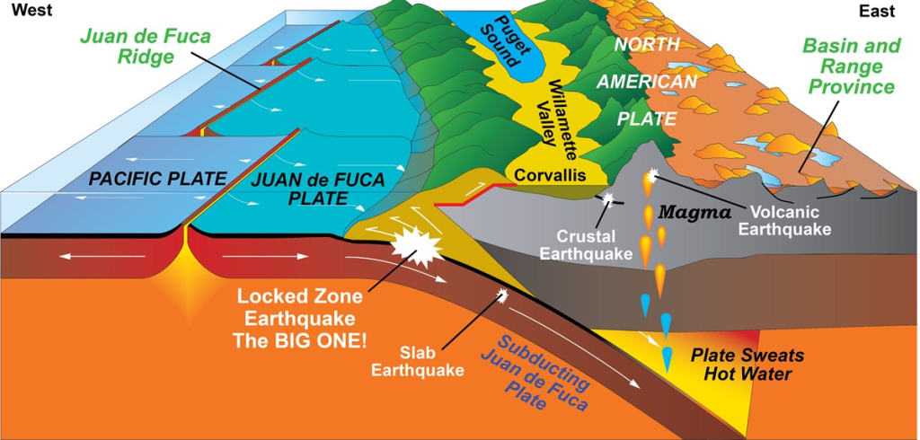
Cascadia Subduction Zone

Slide 7
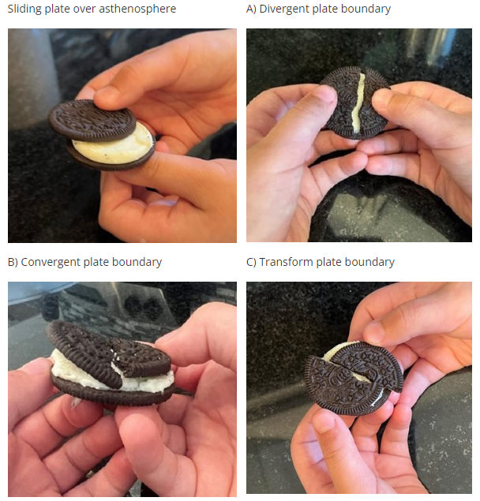
Cascadia Subduction Zone
OPB Video
Red Cross

Slide 8
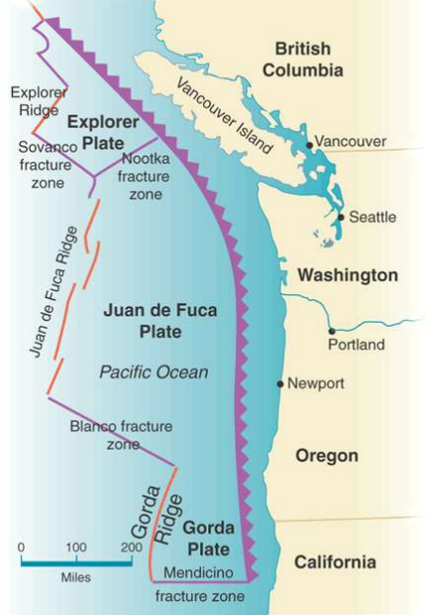
Cascadia Subduction Zone
621.37 miles
140,000 square miles
15 million people + Tourists
Every 223 years
46 Earthquakes
  10,272 year/46 earthquakes = 223.30

Slide 9
Cascadia Subduction Zone
“The Cascadia subduction zone ground motions have longer duration and different frequency content than the ground motions experienced in California, which has formed the basis for most U.S. building codes,”
- Jeffrey Berman, a UW professor of civil and environmental engineering

Slide 10
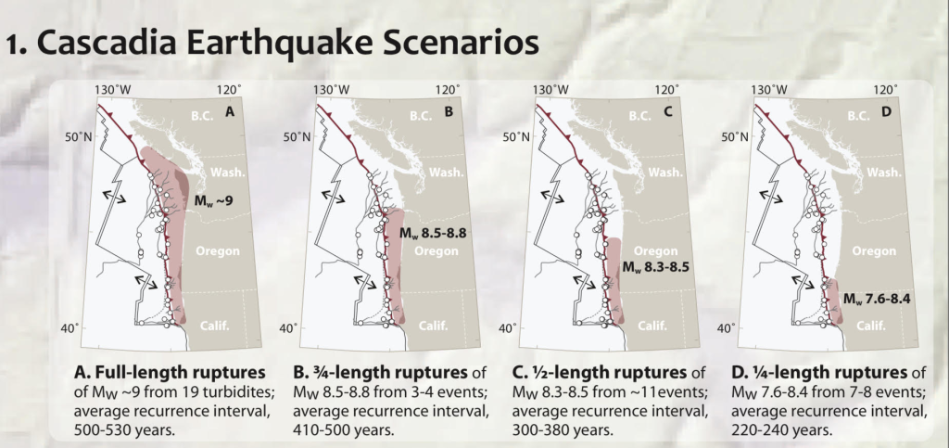
Oregon Department of Geology and Mineral Industries (DOGAMI)

Slide 11
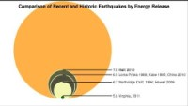

Slide 12
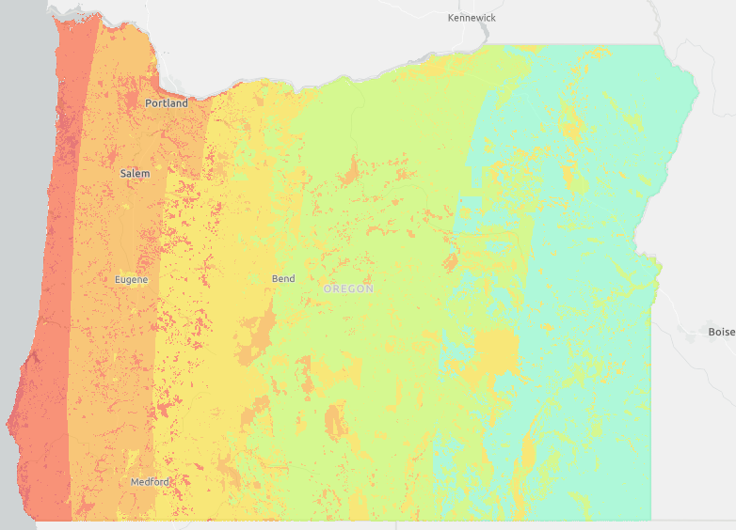
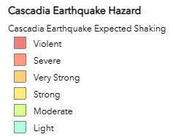
Shaking

Slide 13
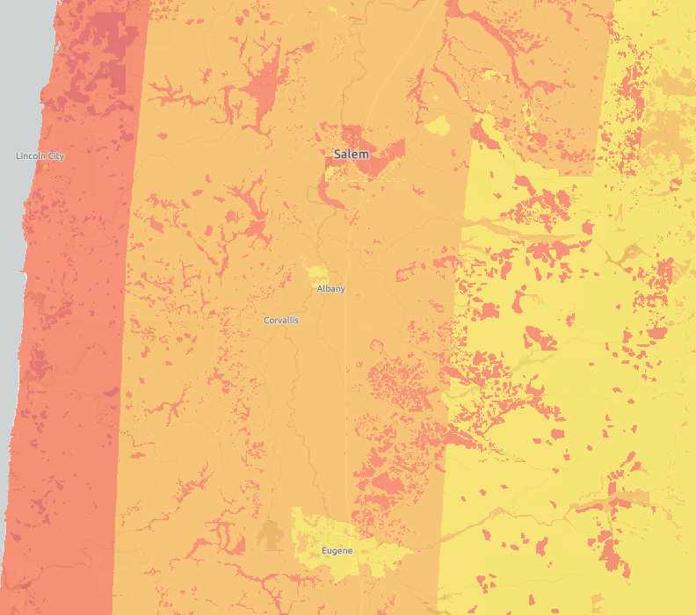
Shaking
https://gis.dogami.oregon.gov/maps/hazvu/

Slide 14
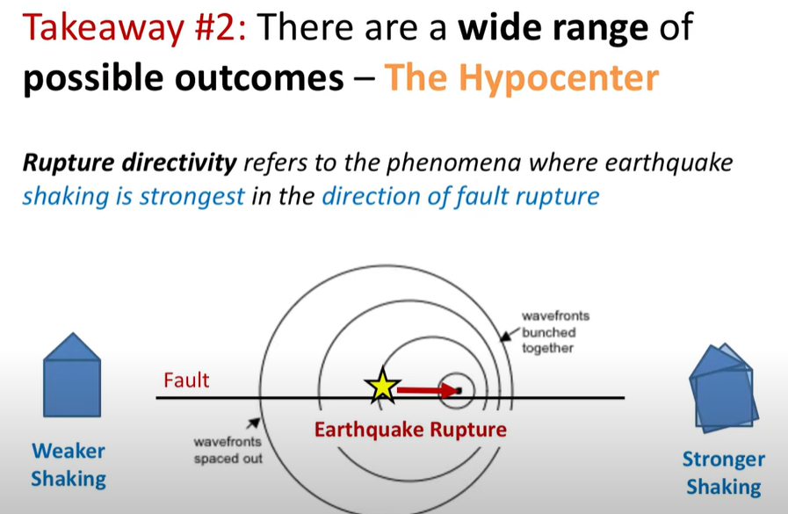
https://www.youtube.com/watch?v=EHCZoHTrr94

Slide 15
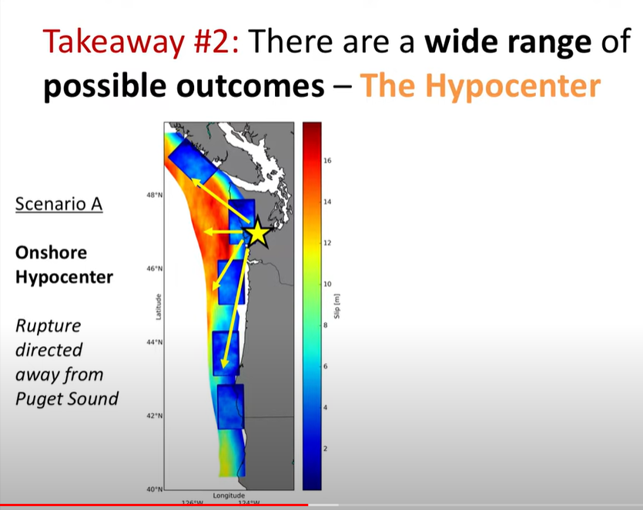

Slide 16
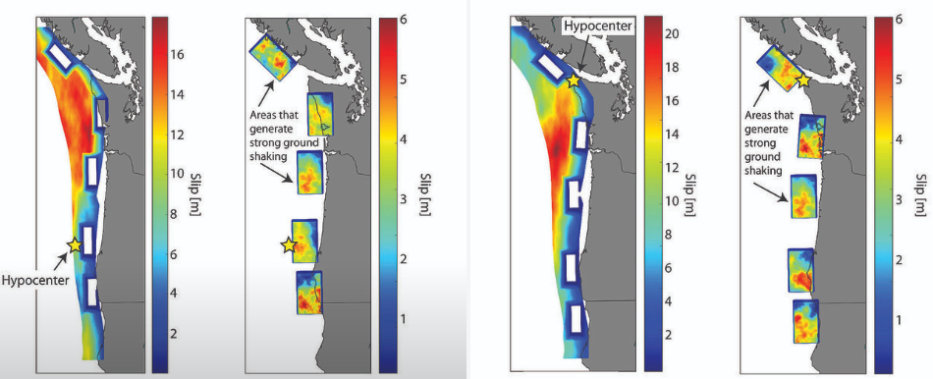
An earthquake where the rupture extends deep and partially inland is weighted at 30%, a shallow rupture that is entirely offshore is weighted at 20%, and a mid-depth rupture that extends approximately to the coastline is weighted at 50%.
UW Sets
Seismological Society of America

Slide 17
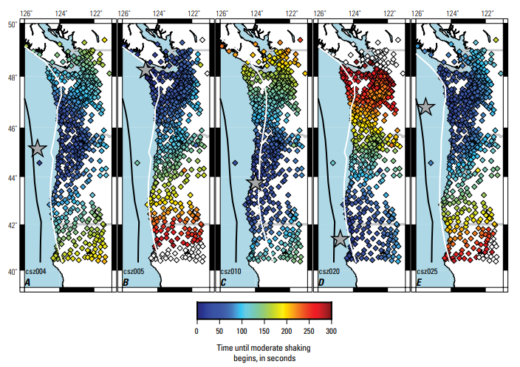
Shake Alert Timing
https://pubs.usgs.gov/of/2021/1026/ofr20211026_v1.1.pdf

Slide 18
Co-Disasters
The Guarantees
Tsunamis
Co-Seismic Subsidence
Landslides
Liquefaction

Slide 19
Creekside Good News
Tsunamis
Liquefaction

Slide 20
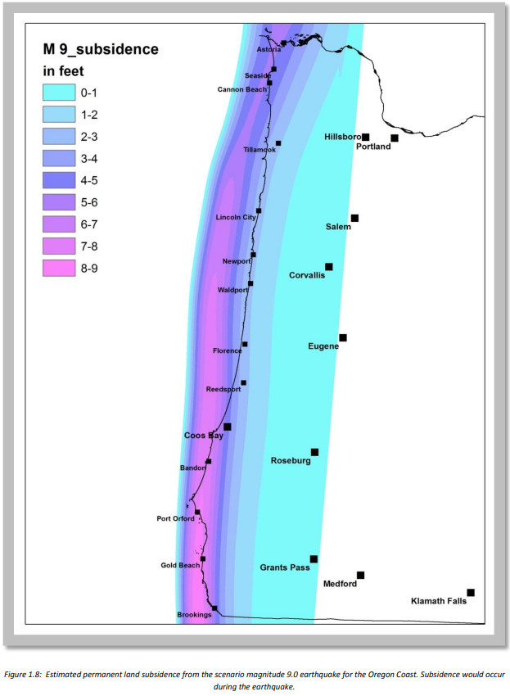
Co-Seismic Subsidence

Slide 21
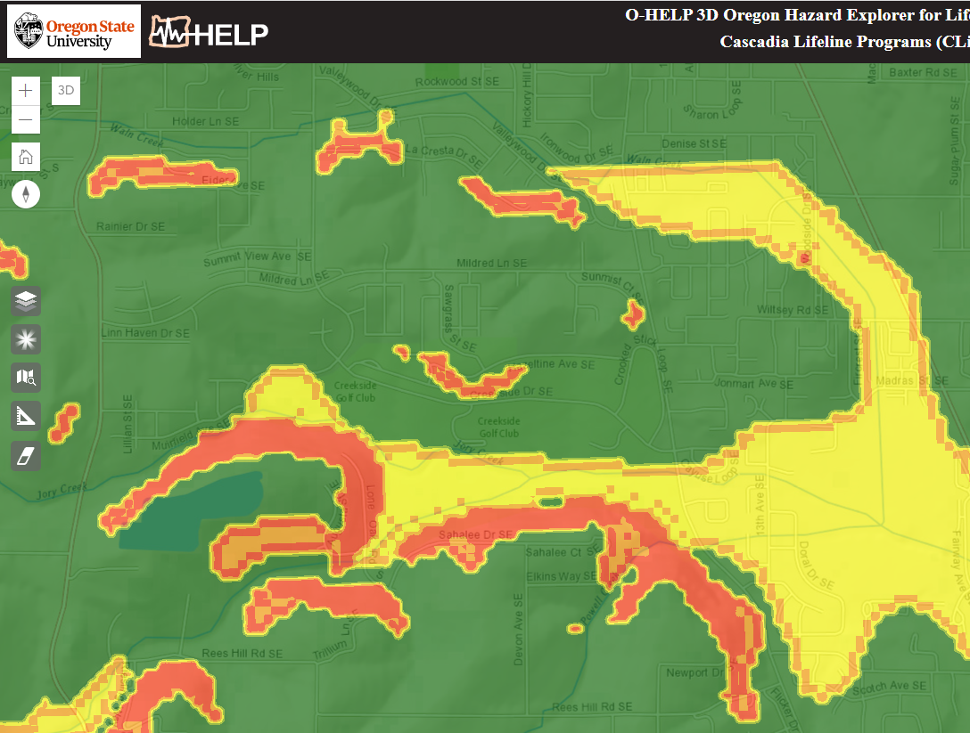
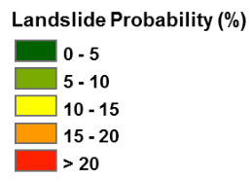
Landslide

Slide 22
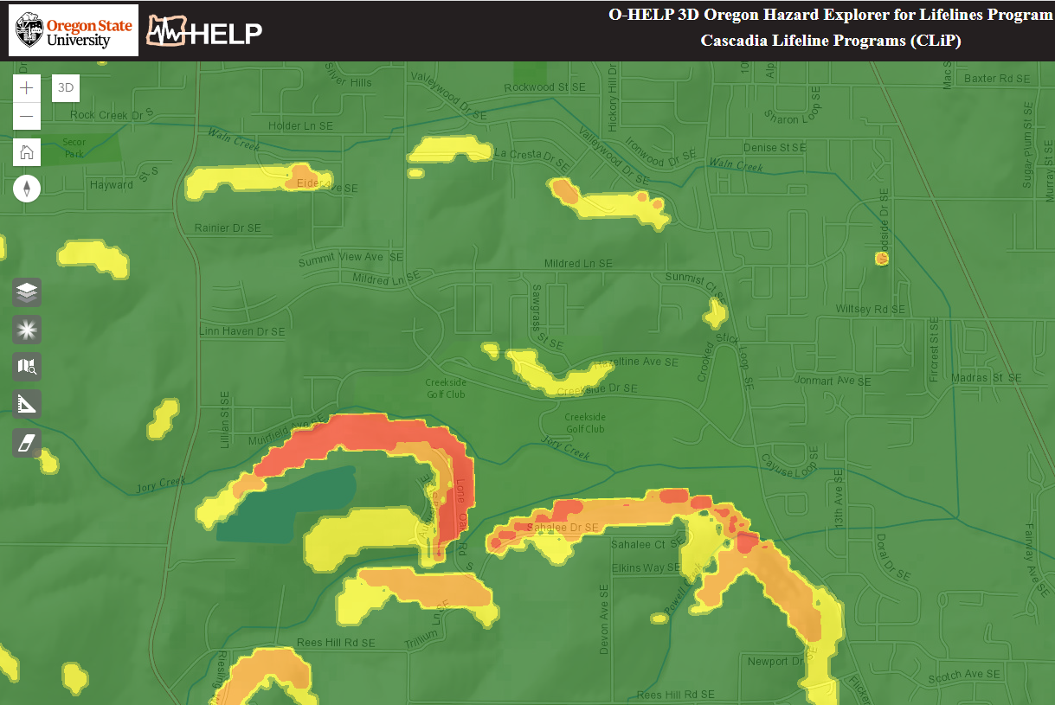
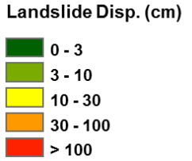
Landslide

Slide 23
Co-Disasters
The “Possibles”
San Andreas
Cascade Volcanic Range
Dam Failure

Slide 24
Detroit Dam Failure
Total failure of the Detroit Dam, with a full reservoir, would cause the smaller Big Cliff Dam to fail also and would inundate Gates, Mill City, Stayton, Aumsville, Turner and Jefferson as well as cause significant portions of Salem and Keizer to be flooded.
Marion County EOP

Slide 25
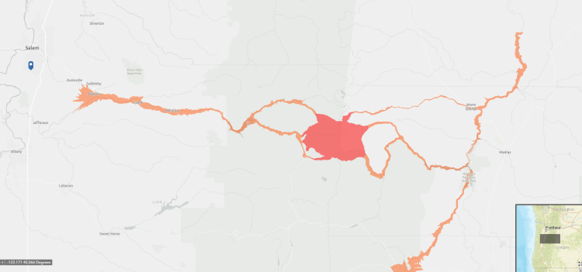
Volcanoes
From Mt. Jefferson, the Moderate Hazard Zone flows along Hwy 22, ending about a mile east of Aumsville & roughly 7 miles east of Salem. (*After the Shaking)

Slide 26
San Andreas/CSZ
“For most Cascadia events < 3500 BP, a corresponding NSAF earthquake occurred shortly thereafter.”
On several occasions, data imply hours of separation at most. Time separation for others is difficult to gage but likely does not exceed ~ 30 years.
Oregon Legislature Presentation by the National Earthquake Hazards Reduction Program (NEHRP)

Slide 27
Ramifications
Emergency Responders
Supply Availability
Impact Area

Slide 28
My Thoughts:
Sooner rather than later
Going to get kinda ugly
The low will be much less low if we are ready.

Slide 29
Water-Ready
1 month to 1 year
14 days for water stations
Is it expensive?

Slide 30
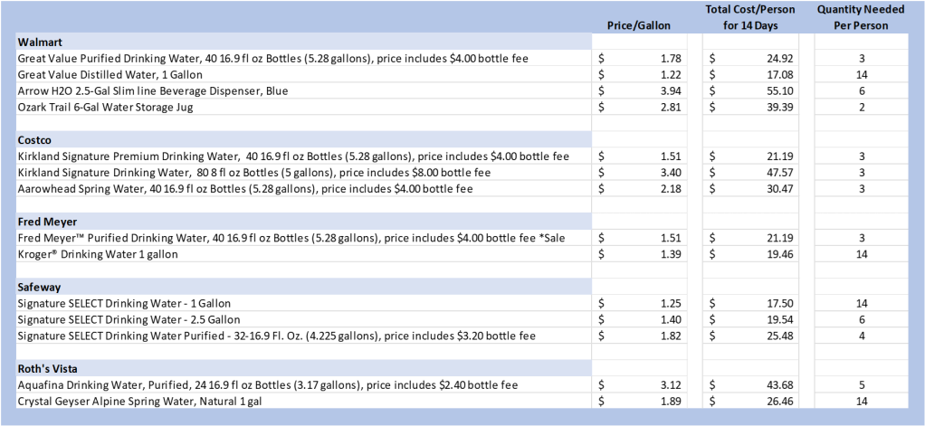
Water-Ready

Slide 31
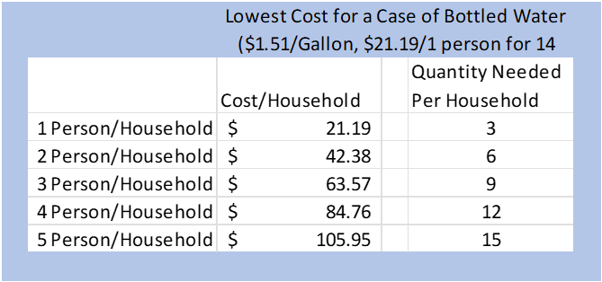
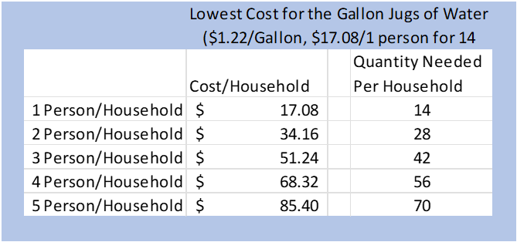
Water-Ready

Slide 32
Favorite Resources
Do 1 Thing: https://www.do1thing.com/
Oregon State University’s O-Help: http://ohelp.oregonstate.edu/
Oregon State University CSZ Preparedness: https://extension.oregonstate.edu/cascadia-earthquake-preparedness
City of Salem 2-Weeks-Ready Challenge: https://www.cityofsalem.net/community/safety/emergencies-disaster-preparedness/get-2weeksready-challenge
DOGAMI HazVu GIS Map: https://gis.dogami.oregon.gov/maps/hazvu/
OSU Preparing for the Cascadia Subduction Zone Event

Slide 33

Questions?

Slide 34
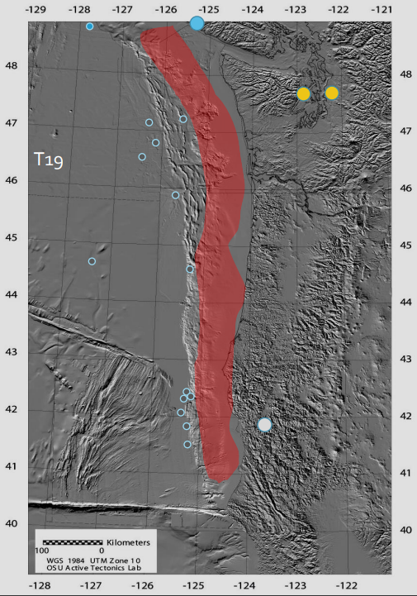
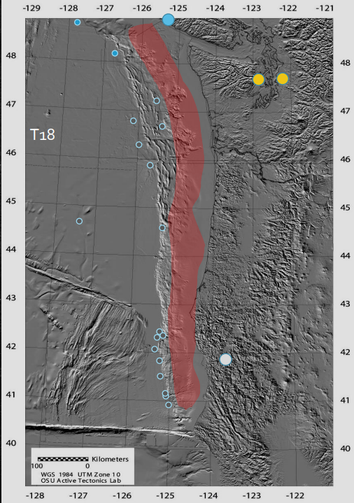
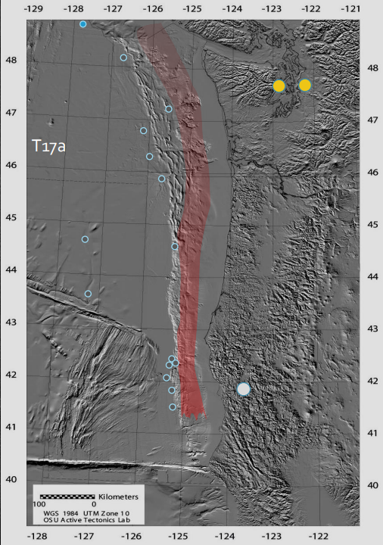
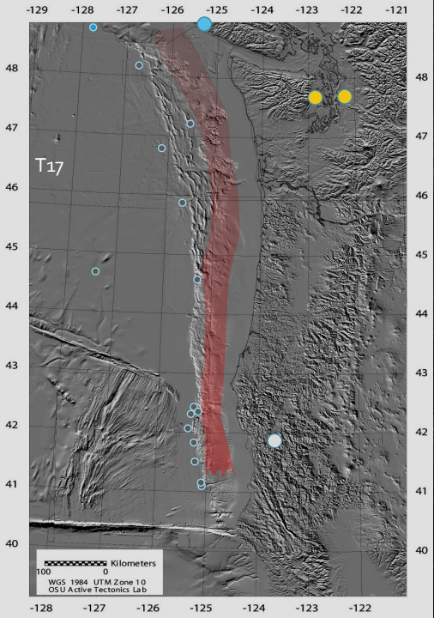
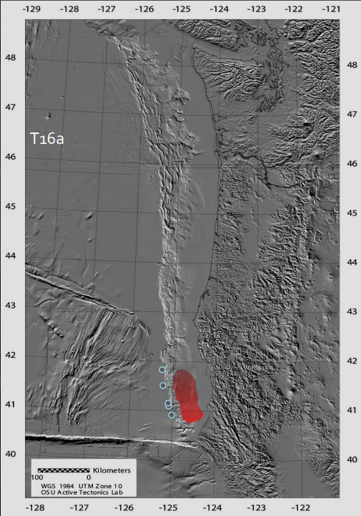
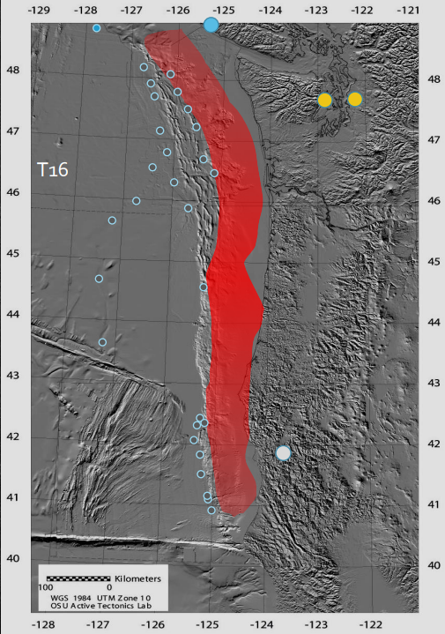
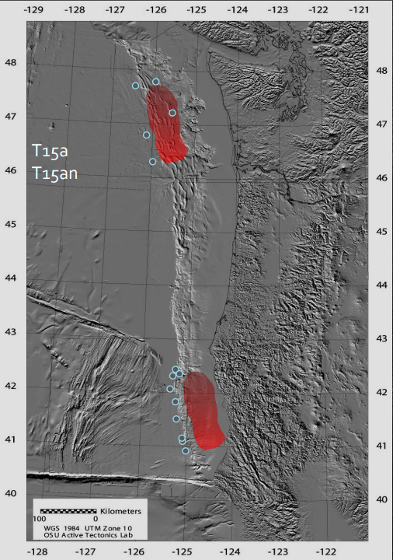
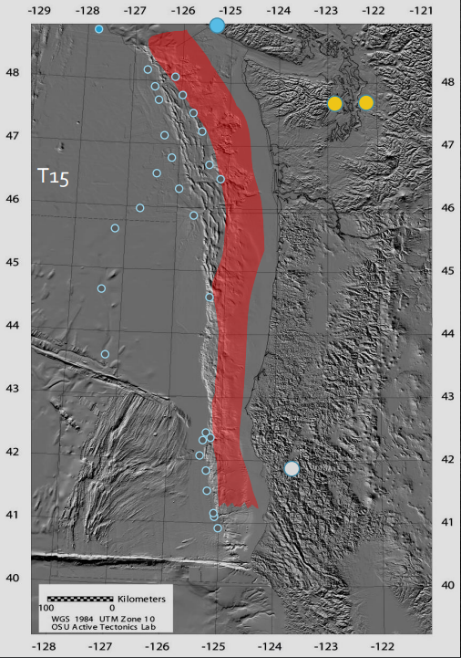
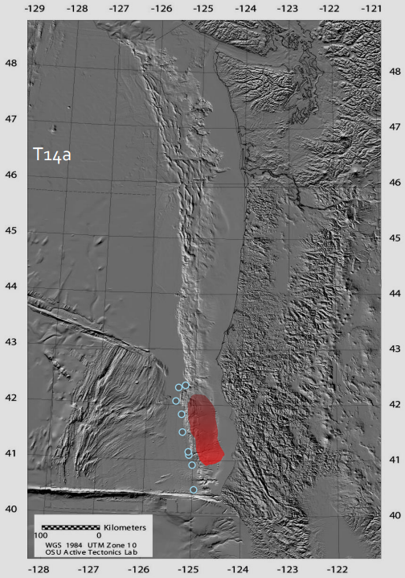
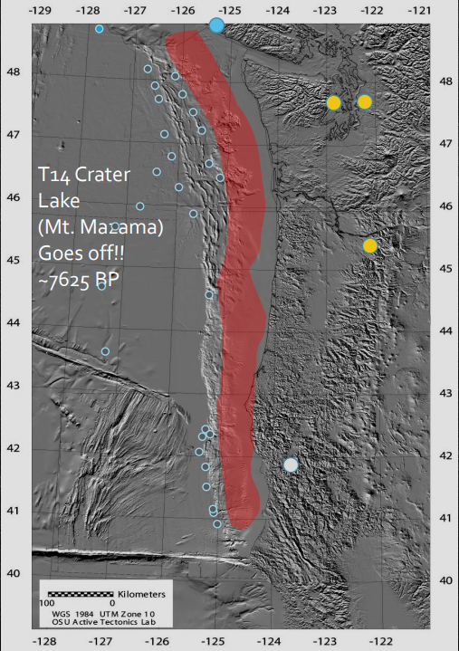
Mw 9.08
Mw 8.50
Mw 8.49
Mw 7.54
Mw 9.09
Mw 8.36
Mw 8.97
Mw 8.17

Slide 35
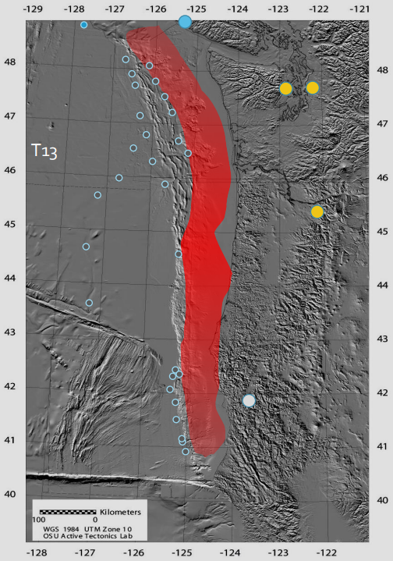
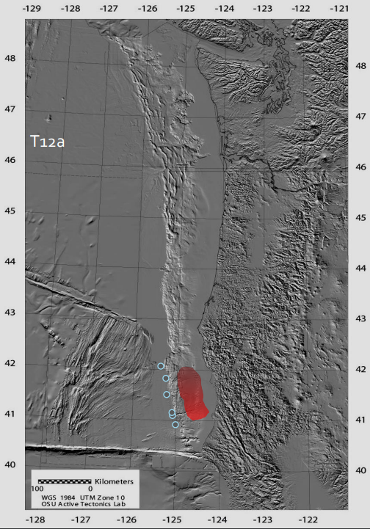
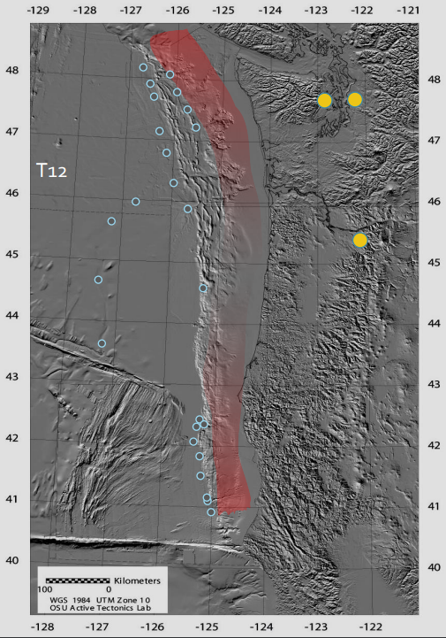
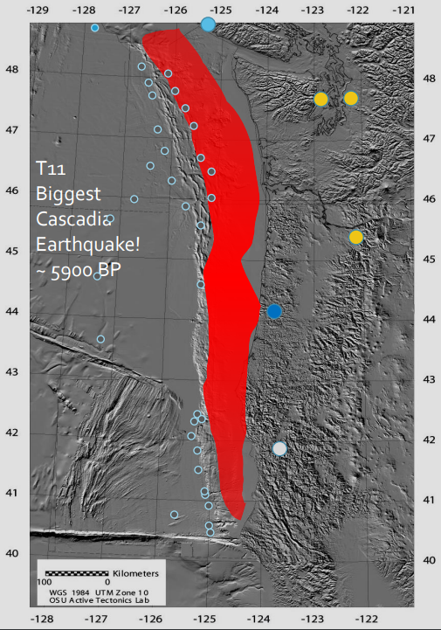
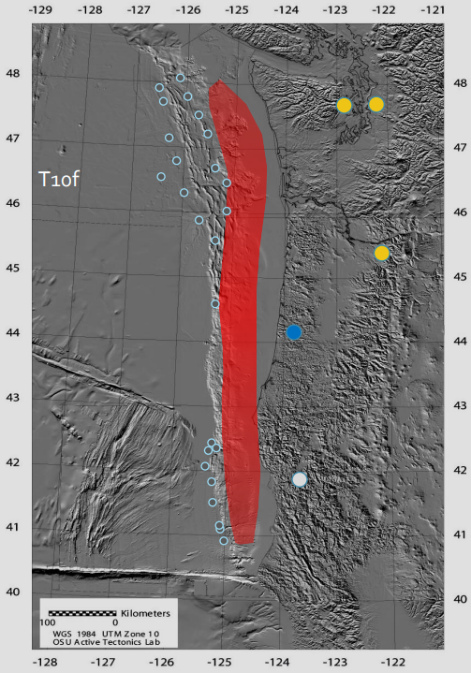
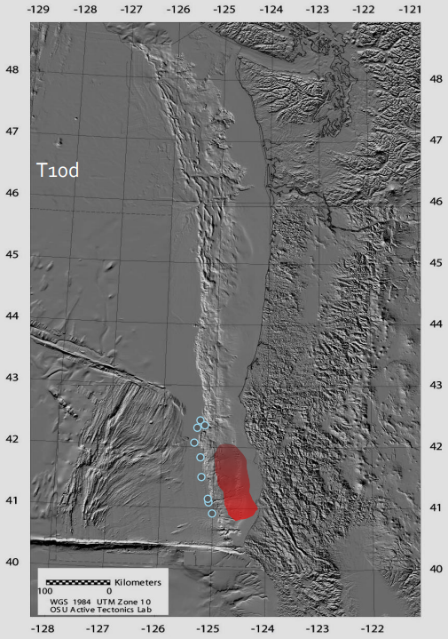
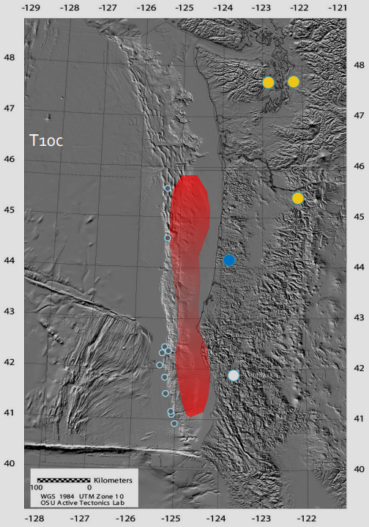
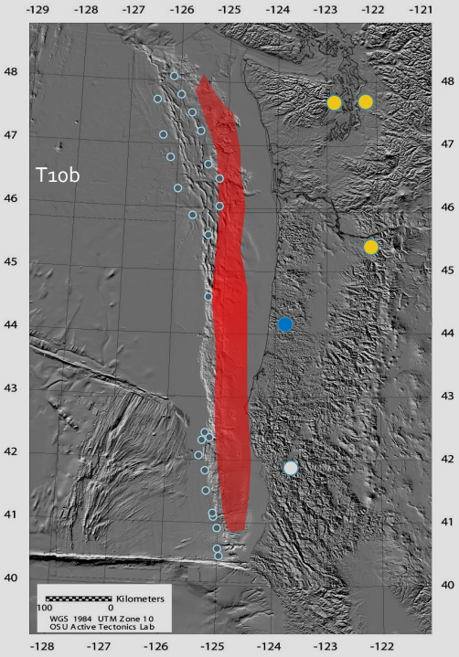

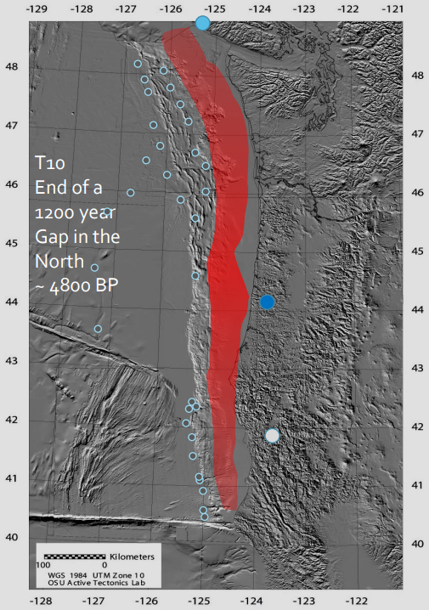

Slide 36
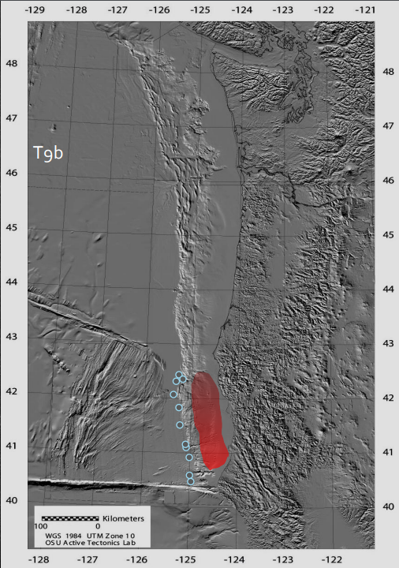
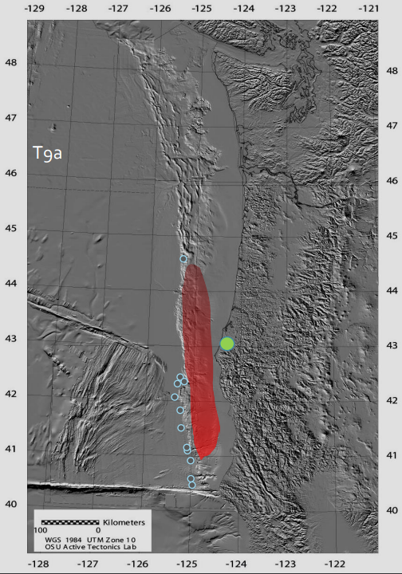
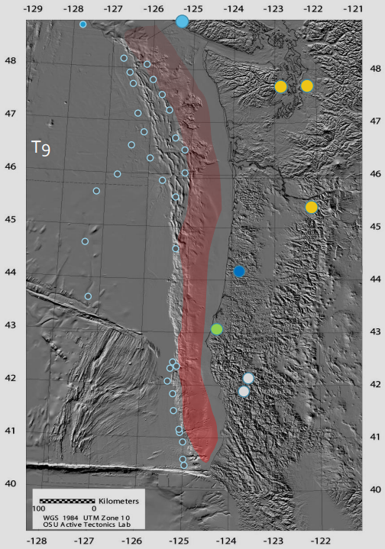
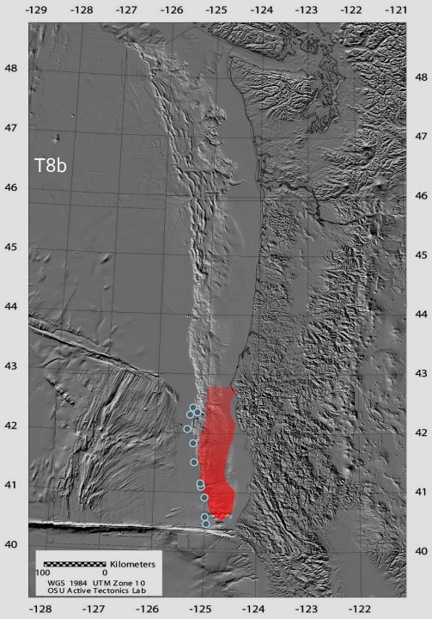
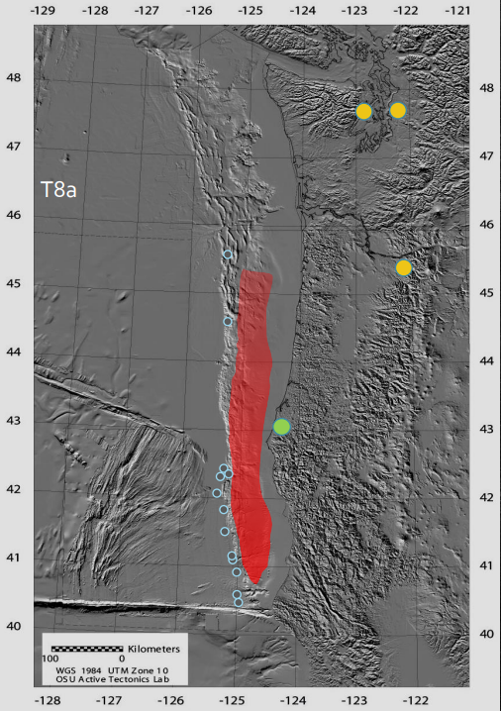
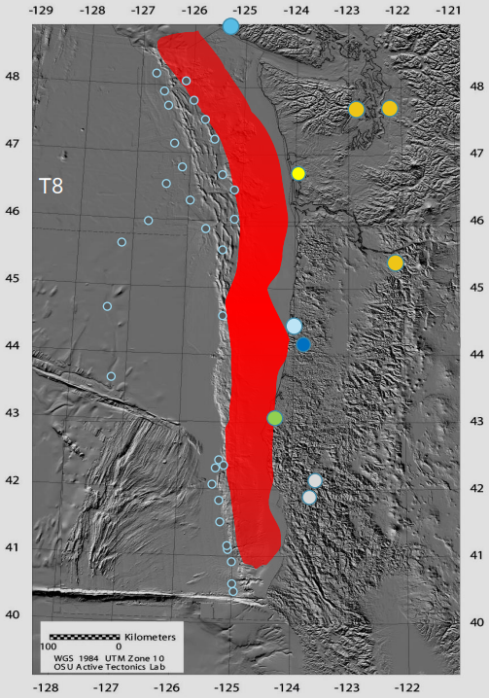
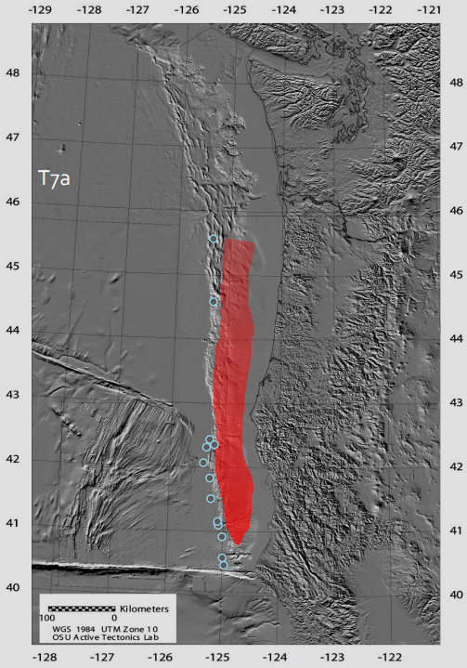
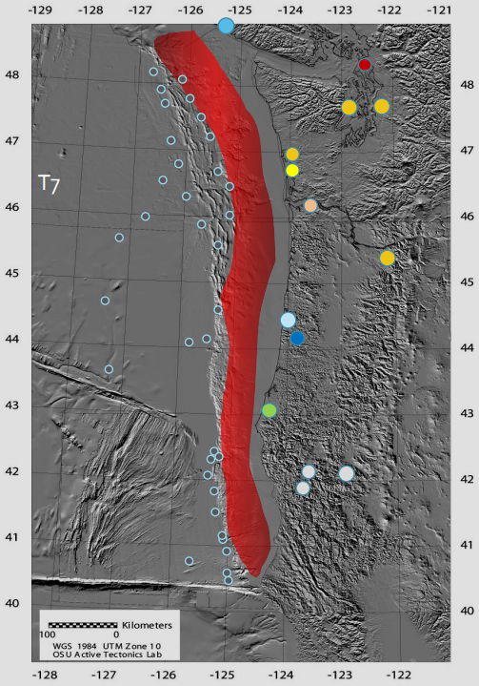
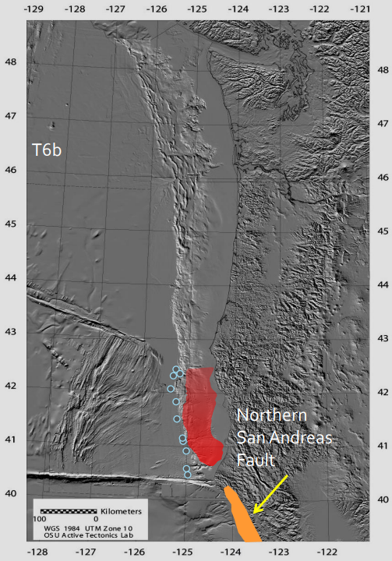


Slide 37











Slide 38






These are the final 4 in the record that led to 46 being used for the 37%

